Slide 1
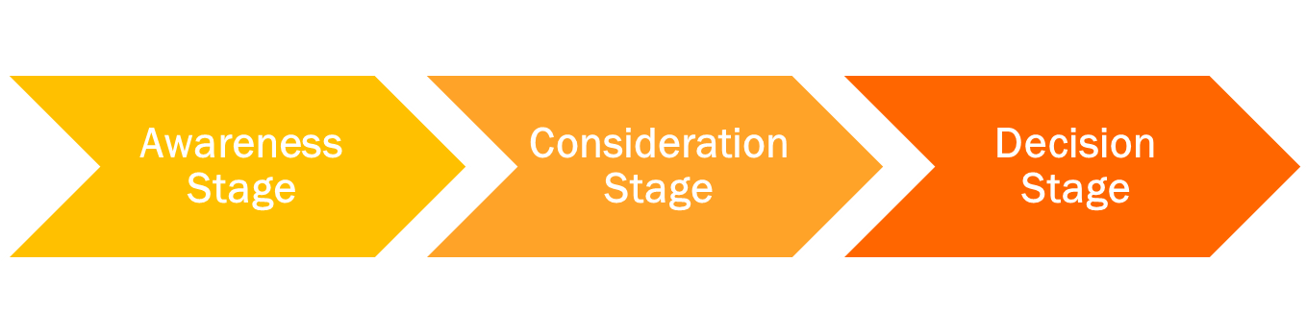

Map & Analyze entire Content Library
Map & Analyze Overall Content Mix, holes, opportunities, overall content alignment with market maturity
 | # % | # % | # %
 | Title A Title B Title C | Title 1 Title 2 Title 3 | Offer X Offer Y Offer Z

Slide 2


Persona
 | Your Persona A | # % | # % | # %
 | Your Persona B | # % | # % | # %

Slide 3
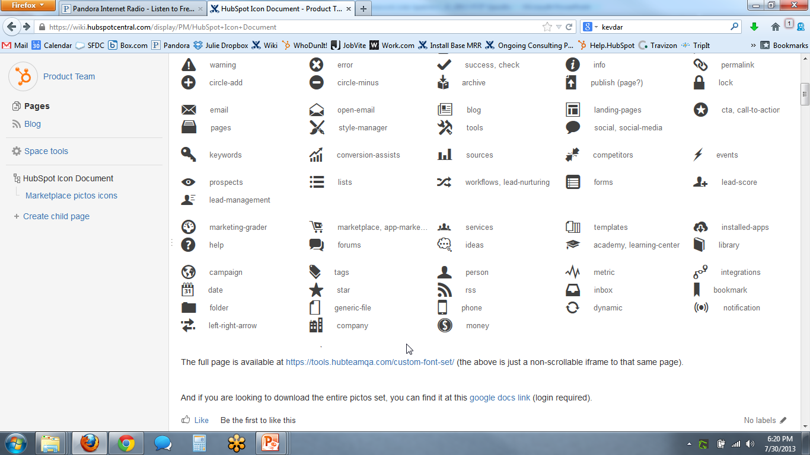
Topic
 | Your Topic 1 | # % | # % | # %
 | Your Topic 2
 | Your Topic 3 | # % | # % | # %
 | Your Topic 4
 | Your Topic 5
 | Your Topic 6

Slide 4
Content Type / Format
 | Your Content Type 1 | # % | # % | # %
 | Your Content Type 2
 | Your Content Type 3 | # % | # % | # %
 | Your Content Type 4
 | Your Content Type 5

