Slide 1
How to Generate Leads
Notes:
Jeetu:
Welcome to the Partner Program training webinar series for marketing agencies.
My name is Jeetu Mahtani and I am joined by Corey Beale. We are both Partner Channel Managers at HubSpot.
Corey:
We partner with marketing agencies of all kinds to help agencies more cost-effectively and more efficiently provide a broader set of inbound marketing and demand generation services to our mutual customers.
Working with our partners, one of the biggest challenges that they have is adapting to a world where clients are asking for one agency that can do everything. The worlds of PR, advertising, marketing, seo, ppc, social media and web design and development are merging. And the feedback I’m getting from many types of agencies is that it’s really hard to do everything, deliver an ROI to clients and grow their agency at the same time.
That’s what HubSpot is helping partners with in many ways. Today, though, we’re going to talk about a framework for diagnosing the complete inbound marketing needs of a prospect or client. We’re going to provide you with a script and a playbook with how we’ve done this for about 10,000 companies.

Slide 2



Nice to Meet You
Jeetu Mahtani
HubSpot Sales Manager
http://www.linkedin.com/in/jeetumahtani
jmahtani@hubspot.com
Corey Beale
Hubspot Sales Manager
www.linkedin.com/in/coreybeale
cbeale@hubspot.com
Hash Tag: #AgencyTransform
Notes:
Corey:
We want to keep these sessions interactive both during and after the webinar. Feel free to reach out to either of us via email or LinkedIn and let’s get Twitter rocking today by using the hash tag #AgencyTransform

Slide 3
AGENDA
1
The recommended sales process
2
What to look for – Lead Targeting
3
How to generate leads as a marketing services firm
4
Leveraging Social Media – Special Section
5
Key Take-Aways
Notes:
Jeetu:
Here’s an overview of what we’re going to talk about today. The big topic is around generating leads. We are going to discuss a couple of approaches for generating leads which include both an inbound approach and a more traditional/outbound approach. We are also going to share some tricks with you on using LinkedIn for generating leads.

Slide 4

Notes:
Corey:
Before we dive right in to the agenda there are a few quick house keeping notes we should make about today’s session.

Slide 5

Notes:
Corey:
The first is that this session is being recorded and we’ll be emailing you a link to the recording by the end of the day. If you have colleagues or partners who were unable to attend today, definitely have them watch the recording prior to the session next week. Please post any questions into the chat pane and we’ll answer any questions towards the end.

Slide 6
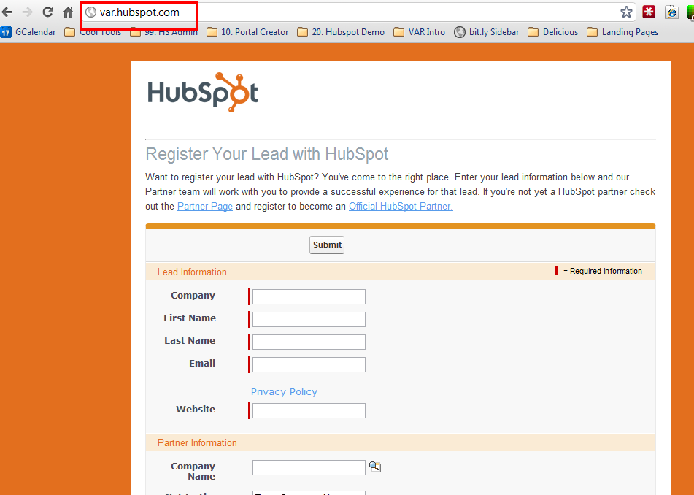
Notes:
Corey:
Register your leads, as often as possible and as many as possible. This will help your channel account manager focus the time you spend together and help coach you through to achieve some big wins on these accounts.

Slide 7
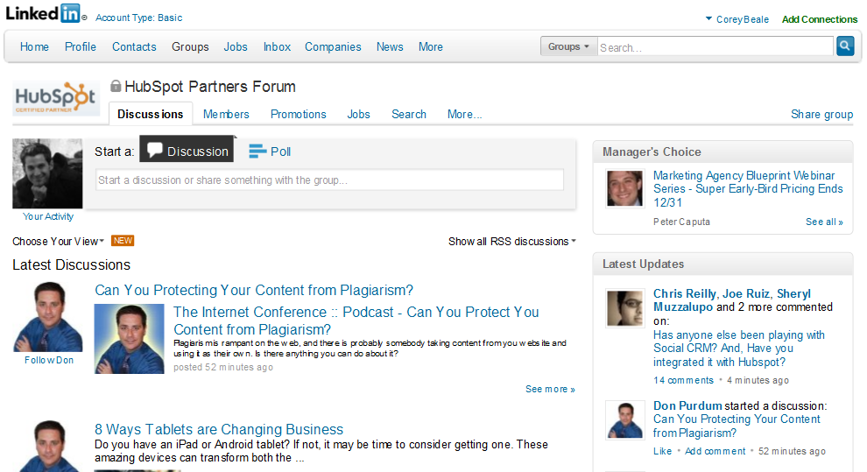
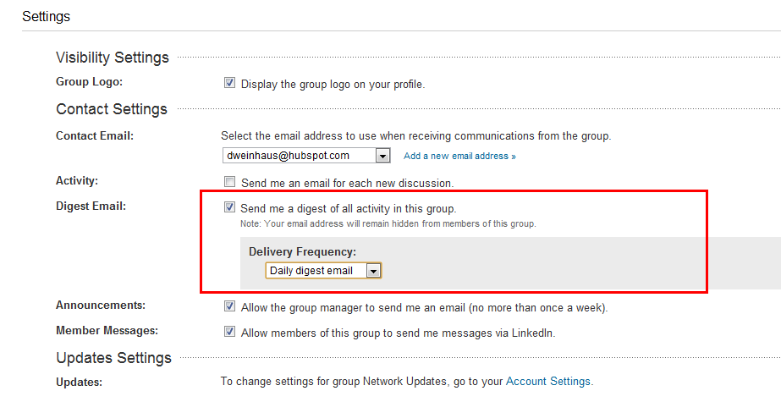
Notes:
Corey and Jeetu (share sales collaboration):
If you haven’t already make sure you have joined the LinkedIn Group “HubSpot Partners Forum” and make sure to setup the email settings for a daily digest of all activity in the group so you don’t miss anything to help you sell better, move quicker and network easier.

Slide 8
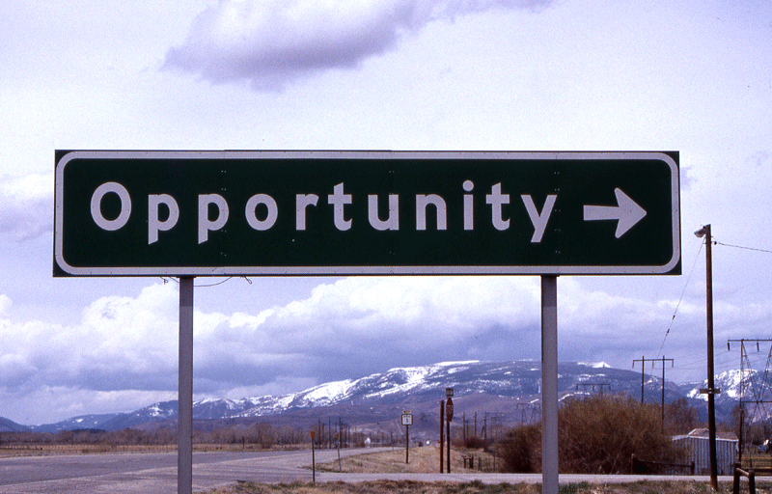
Notes:
Corey:
If you have an opportunity in play right now that you are working be sure to schedule time with your Channel Account Manager asap. He/she will help you determine the best ways to approach next steps and what items you’ll need to be successful.

Slide 9
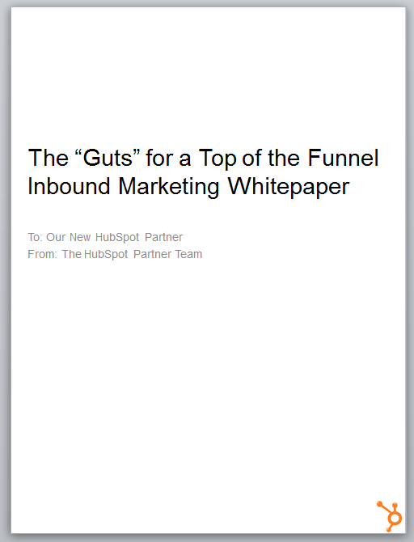

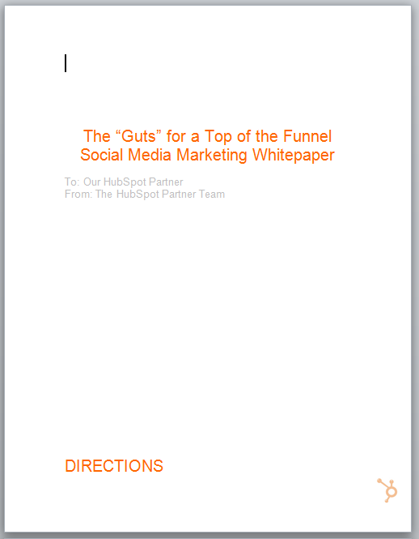
Notes:
Corey:
Since we’re talking about leads today I wanted to throw in a friendly reminder to get your eBooks start using them on your website TODAY to start generating inbound leads ☺
(emphasizing they can use this for their own lead generation efforts)

Slide 10
The Recommended Sales Process & Methodology
1
Notes:
Corey:
Ok I’m all done cleaning house so let’s get down to it and start talking about the HubSpot sales process and methodology.

Slide 11
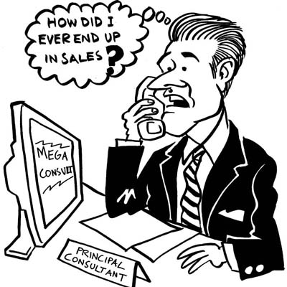
Notes:
Corey and Jeetu (shares Corey and JM’s background):
Some natural born salespeople on the call and probably many others who view it as a necessary evil. That is okay!
At the end of the day, we are all in sales. Because you think you hate selling does not mean you are or will be bad at sales
It is your job to find the companies you can actually help and help them. You are doing the people you call on a favor! Even if you decide you are not the answer for them, you are still going to point them in the right direction.
If you ever hear yourself saying I hate selling, go out and find a problem at a prospect who has a problem in their business, and help them solve it, regardless of the solution.

Slide 12
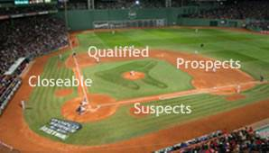
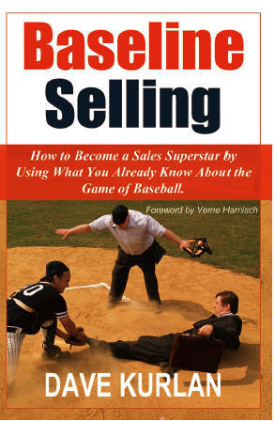
Notes:
Jeetu:
This sales process has its roots from a sales training company called Kurlan and Associates. I got trained at Kurlan about 5 years ago. Our Director of the Channel Peter Caputa also got coached at Kurlan a few years ago. Kurlan is run by Dave Kurlan who is a world renowned sales coach and also has written a book called Baseline Selling. I’d highly recommend that you put this book on your reading list.
Please note that our goal is not to become your sales coach but rather share a framework that you can leverage to a large extent. If you are looking to master sales and would like a dedicated sales coach, let us know and we’ll make an introduction to Dave and his team.

Slide 13
Generating Leads
Researching Leads and Prospecting
Connecting and Qualifying
Inbound Marketing Assessment (IMA)
Diagnostic and Goal Setting
Present Solution
Contract and Close
Surprise!
Notes:
Jeetu:
So here is the sales process we are going to be using as our framework today and over the next 7 weeks. Today’s session is focused on generating leads. Once you have leads, you will research them, pick up the phone and make that call. Once you connect with the prospect, you are going to deliver your message like a movie star! We are going to share with you a Connect Playbook which will comprise of a script, sound bites, objections to expect, and your goal for the next step. This is when you start your initial qualification. Following the connect, you are going to have a scheduled call during which you are going to continue your qualification by executing on an Inbound Marketing Assessment also known as an IMA. At the end of the IMA, you should have “trusted advisor” status and do an inoffensive close during which your prospect agrees they need your help and would like to define their marketing goals with you. Following the diagnostic and goal setting call, you are going to share the solution to hit their goals. Finally a contract and closing out the deal.

Slide 14



Inbound Marketing Sales Methodology
1. Research/Lead Gen
Find Prospects to Call On
2. Prospect
Get to a Connect
Lead
3. Connect
Schedule the Assessment
4. QUALIFY
Determine worthiness for next step
OPPORTUNITY
5. Diagnostic & Goal Setting
Align business goals with activities
6. Presentation & Experimentation
Present Solution and/or Trial
7. Contract & Close
Agree to Proceed
Notes:
Corey:
Here at HubSpot every time we get a new sales employee we have them print this slide out and put it on their desk. We’re advising you do the same for your office or home office. It’s critically important not to skip steps in the methodology and follow them to a tee. It will ensure you are bringing the right people forward.

Slide 15
What to Look For - Lead Targeting
2

Slide 16

Keep an Open Mind…Prospects Come From All Over
*http://www.hubspot.com/customer-case-studies/ctl/all-posts/
Notes:
http://strengthplay.com/wp-content/uploads/2011/06/open-minded.png
Corey:
This idea of different people, companies and industries is exemplified on our case studies page. You’ll find dozens of each category within the case studies page on the HubSpot website.
Staffing Agency Attracts More Qualified Talent with HubSpot Software
Mystery Solved! How an Events Company Expanded Business Nationwide with HubSpot
Shipping Company Shifts From Traditional Marketing & Doubles Quote Requests
International Industrial Company Improves Web Traffic & Reach in 3 Months
Pharmacy Development Services Dramatically Increases Organic Traffic
Moonworks (Home Remodeling) Uses Marketing Analytics to Increase Conversion Rates
Commercial Signage Company Doubles Leads With HubSpot
Professional Services Company Improves Lead Capture & Nurturing With HubSpot
Fencing Company Expands Nationwide Using HubSpot
IdeaPaint (Specialty Products) Uses Marketing Analytics to Make Smart Investments
Payroll Services Company Attracts 550 Blog Subscribers in 6 Months
Massage School Stops Buying Leads by Leveraging HubSpot
TotalMobile's Lead Generation Success Featured on BostInnovation
Sales Training Company Reduces Cost Per Lead with HubSpot
Boston Health Club Drops Direct Mail and Pumps Up Leads with HubSpot
Enterprise Software Company Reduces PPC Spending with HubSpot
Closet Design Company Decreases Cost Per Lead by 60% with HubSpot

Slide 17
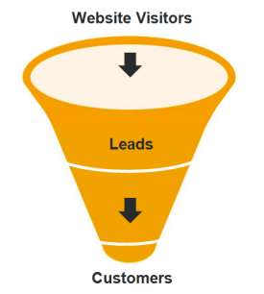
Notes:
Corey:
So let’s by talking about lead generation in general and about the types of people you should be spending your time with. One thing that is crucial to a selling process is who you spend your time with. When you break down mistakes made with the wrong types of people it can really add up in any given month, particularly if you are making the same or similar mistakes over and over again.
That being said let’s talk about being intentional.

Slide 18

What does my ideal client look like?
Who should I be talking to?
Who do they buy from?
What problems are they solving?
What concerns or frustration are they dealing with?
Is there a consistent profile or any trends?
Notes:
Jeetu:
In order to generate leads whether inbound or outbound, you need to start by asking who are you targeting and starting thinking from their mindset. You should be asking questions like what is my ideal client look like, who should I be talking to. Where do my ideal clients buy from and who do they buy. What are their problems and pains that they are trying to solve. What concerns of frustrations are they dealing with. Basically, you are trying to build a profile of your ideal prospect so everything you do from a lead generation standpoint keeps this ideal profile or persona in mind. I’d highly recommend each of you start thinking about these questions and start defining your target since it becomes the foundation for your lead generation efforts and also up upcoming steps in the sales process.

Slide 19
“I target B2B companies in the software, technology, and infrastructure space. They have $2M - $10M in revenue. They usually have 1 or 2 traditional marketing people (MARCOM). They have at least 5+ salespeople who are usually cold calling leads that are based off lists. They have a website which is mostly brochureware and is currently not generating any leads. The CEO or VP/Director of Marketing is looking into other sources of leads in order to hit their annual revenue goals. They are frustrated with SEO companies who promise them leads and/or frustrated with paying Google for PPC.”
Notes:
Jeetu
After building a profile of your ideal prospect and understanding their pains and challenges, lets put this into a sentence now. Lets call it the Ideal Prospect Sentence.

Slide 20

Concept of a Lead
Budget - Rev $2M - $50M
Should Have A Sales Funnel
Notes:
Jeetu:
Take that ideal prospect sentence and create a printout or cheatsheet for your team and you so this is always in front of them. This becomes a set of concrete criteria for all your lead generation campaigns.

Slide 21

Tread Carefully
Pursue
Steer Clear
Notes:
Jeetu:
If you noticed in the earlier slide, I had a clear target market like B2B and specifically software, technology, and infrastructure. Corey can you speak a bit more to targeting guidelines.
Corey:
I definitely can, this is another really important part of your lead targeting efforts and research stage of the sales process. HubSpot works with over 6,000 customers so we’ve got a good idea as to what works as a fit and what potentially doesn’t.
Tread Carefully
Auto Dealers
Lawyers
eCommerce
No Sales Funnel
Pursue Heavily:
Construction
Consulting
Education
Health Services
Professional Services
Manufacturing
Software
Technology
Many more….
Steer Clear:
Pure Retail

Slide 22
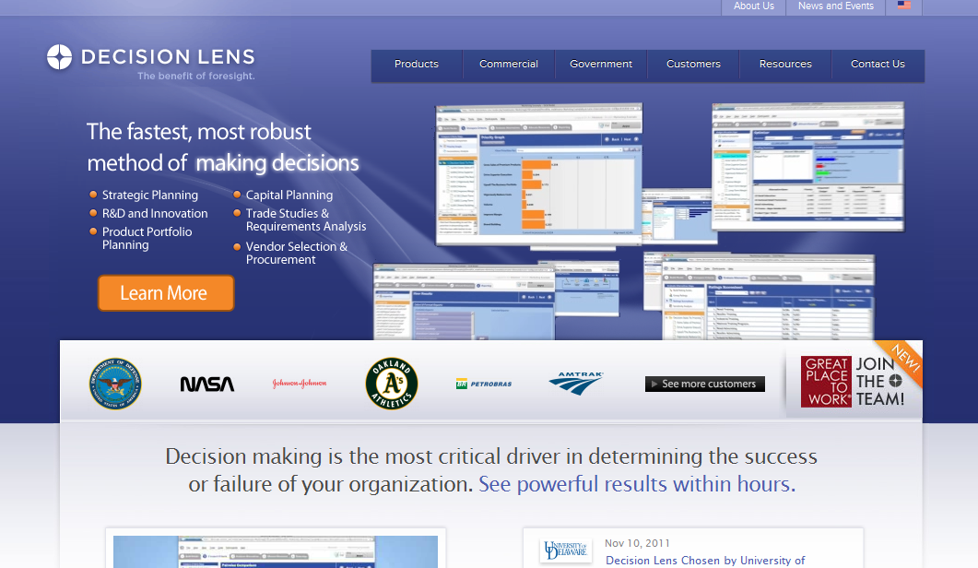
Big Bucks or Whammy?
Notes:
Corey:
Ok so let’s play a little game, not sure if anyone else remembers the game show big bucks or whammy, but it’s a fun one and let’s give it a shot.
Jeetu/Corey to each offer their idea on the lead
Concept of a lead
Revenue should be good due to the client base

Slide 23
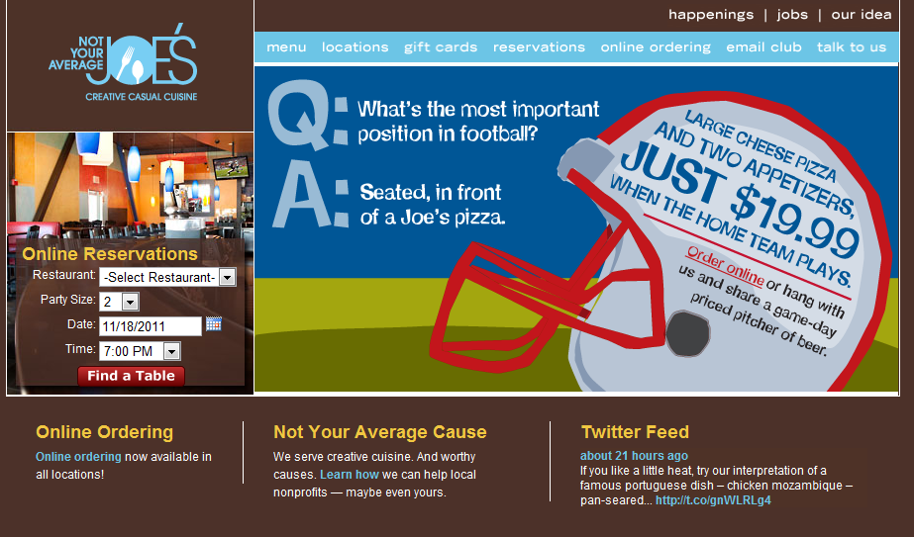
Big Bucks or Whammy?
Notes:
Jeetu/Corey to each offer their idea on the lead
No concept of a lead
- Probably difficult to related marketing activities to leads and customers

Slide 24
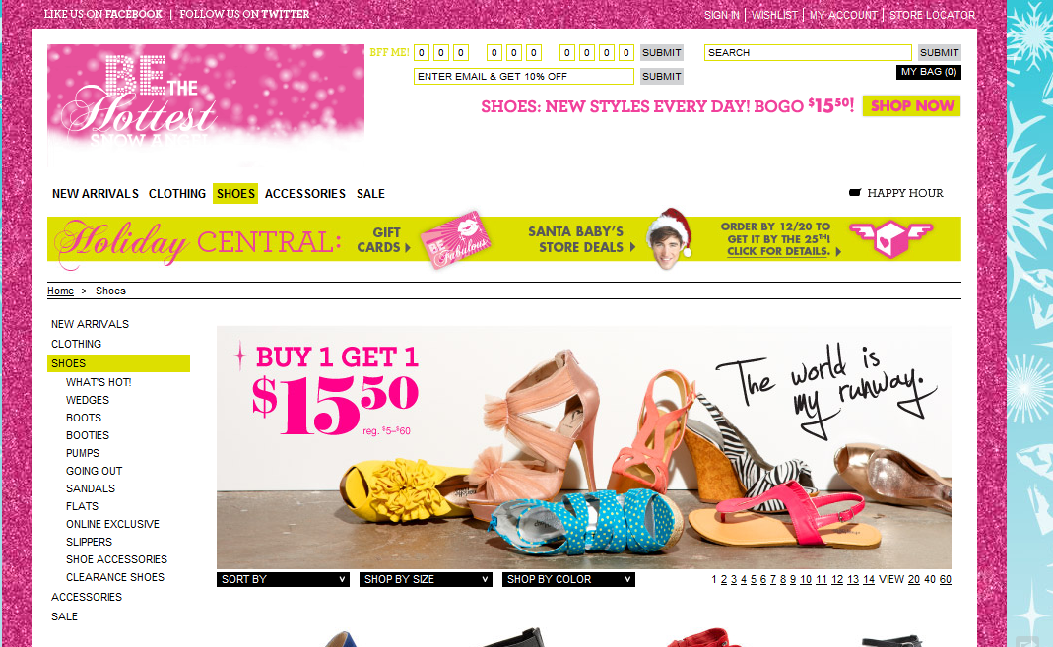
Big Bucks or Whammy?
Notes:
Jeetu/Corey to each offer their idea on the lead
Potentially could be a good client
- HS enables you to related marketing to eCommerce transactions

Slide 25


Consider Selecting a Couple Industries;
  with a high lead value
  where you have comfort/ referenceable successes
Start to develop content around industries
Be proactive about prospecting in industries
Box yourself in
Get analysis paralysis
Forget that targeting is iterative
Feel that industry targeting is the only way to go
Notes:
Corey:
Speak to slide

Slide 26
The Ways to Generate Leads as a Marketing Services Firm
3
Notes:
Jeetu

Slide 27

Notes:
Jeetu:
So now that we know our ideal prospects to taret, let’s talk about the two paths you can take to begin attracting them into your lead funnel

Slide 28
Landing Pages
Social Media
Client Referrals
Networking
Website
Email Marketing
Blog
SEO
SEM/Paid Media
Cold Calling
Notes:
Jeetu:
One path is the inbound approach which is what you are doing with HubSpot and your product consulting, shown here in the blue circles. It also forms the core of your ongoing Inbound Marketing retainers and associated services that you sell to your clients. So your inbound lead gen components include SEO and optimizing your site, content generation with blogging, participation in social media, email marketing and lead nurturing.
n the flip side, you should also continue with any outbound tactics such as networking, asking your clients and contacts for referrals, and also possibly cold calling shown here in the green boxes. If some of your are shocked that I say cold calling, well I can understand why since we coined the term inbound marketing but in reality outbound/cold calling can also work. it is much harder but there are ways to combine outbound and inbound tactics. So the idea is to be strategic with your efforts especially early on since the Inbound approach takes time to kick in and start generating leads. While you are working on the implementation of your inbound tactic, you should continue with any outbound tactics.

Slide 29
Networking
Cold Calling Lists
Client Referrals
Seminars
Form your Own Group
Other Networking Events
Buy/Rent List Rentals
Library
Online Research
ASK!
LinkedIn
Notes:
Jeetu:
On the traditional front I wanted to spend a minute diving a bit deeper in to those 3 green boxes because as a marketing services professional each one of those can be a viable way for you to generate new business. When thinking about outbound tactics, you should always keep your ideal prospect in mind since it will help you decide where and how much time you should spend on each of these circles.
Ask –
if you needed what I do or if you have ever utilized what I do in the past – where would you look for a person to do that?”
Website of a current customer or prospect – who do they work with? Who are their current customers?

Slide 30
Notes:
Corey:
Whether you use one approach or a combination of the two you need to find a way to turn your website in to a fully functioning sales funnel. As you’ll learn in product training there are several ways to do this that you are probably doing right now. CTA’s, blogging, landing pages, lead nurturing/email marketing.
One thing most people don’t realize when trying to create this is having several different offers. It’s not good for anyone if your only landing page or call to action is contact us. Only 3% of your traffic is ready to do some sort of business with you today, so you need to capture the other 97% with a more risk free offer that can at least begin the sales process.
A combination of top of the funnel, middle of the funnel and bottom of the funnel offers is critical to your success in this field. Let’s take a look at how one partner in particular, Kuno Creative has implemented this on their website.

Slide 31
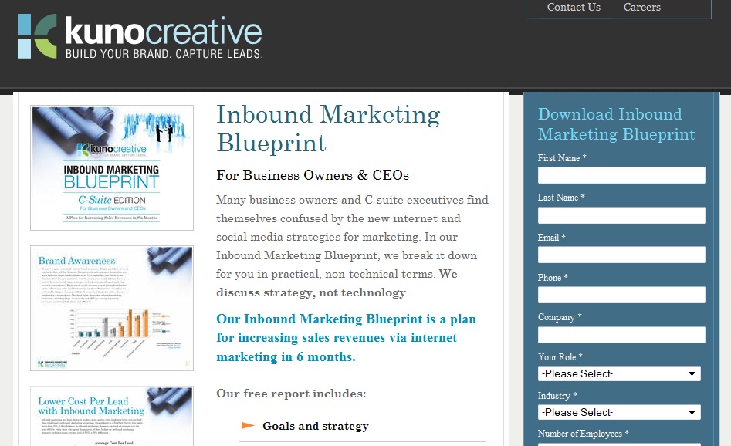
Notes:
Corey:
TOFU

Slide 32
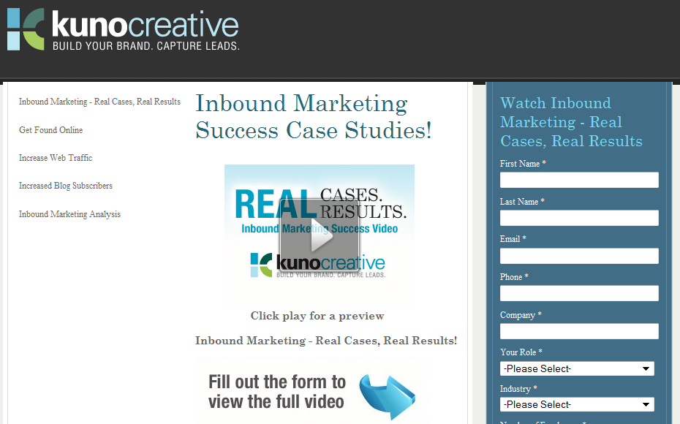
Notes:
Corey:
MOFU

Slide 33
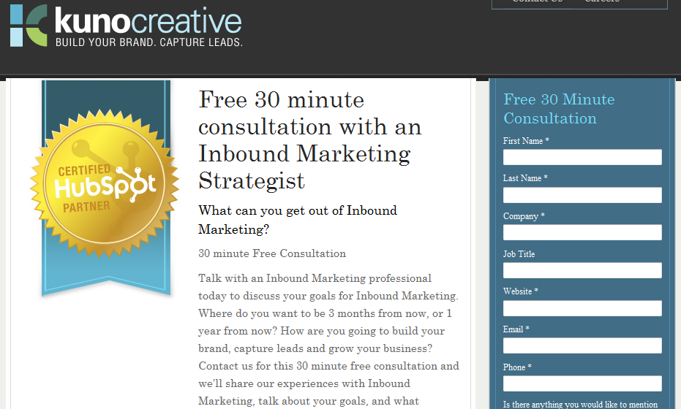
Notes:
Corey:
BOFU

Slide 34
Special Section: Leveraging Social Media
4
Notes:
Jeetu:
Lets talk about LinkedIn and using it to generate leads. Based on feedback from other Partners and also looking at HubSpot’s own lead generation channel, LinkedIn is definitely one of the top channels. For example, in the last 12 months, 15% of our leads generating from social media channels has come from LinkedIn.

Slide 35

Answers
Groups
People Search
Direct Ads
Notes:
Jeetu:
The other way is to be strategic within the social media channel itself and wisely use the tools it lends to you.

Slide 36
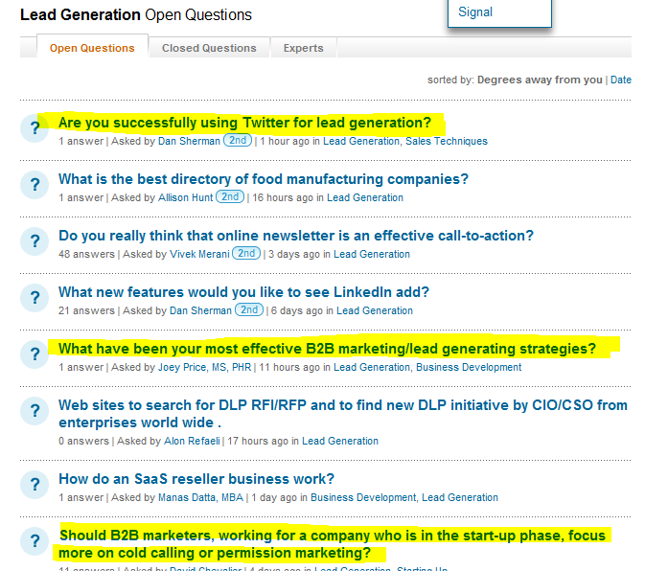
LinkedIn Answers
Notes:
Jeetu:
The first where you can share your thought leadership is in LI’s Answers section. I went to LinkedIn a few days ago and I saw tons of great questions that I had answers to. Now would be the better approach – send them a cold email saying I would like to sell them something or the more indirect approach where I give them feedback and advice on their questions. I suspect the more indirect approach. With the sharing and answering their questions approach, you are showing that you are different, not looking to sell but rather just solve their pain by giving them advice…basically you are looking out for them and establishing yourself as someone they can trust.

Slide 37
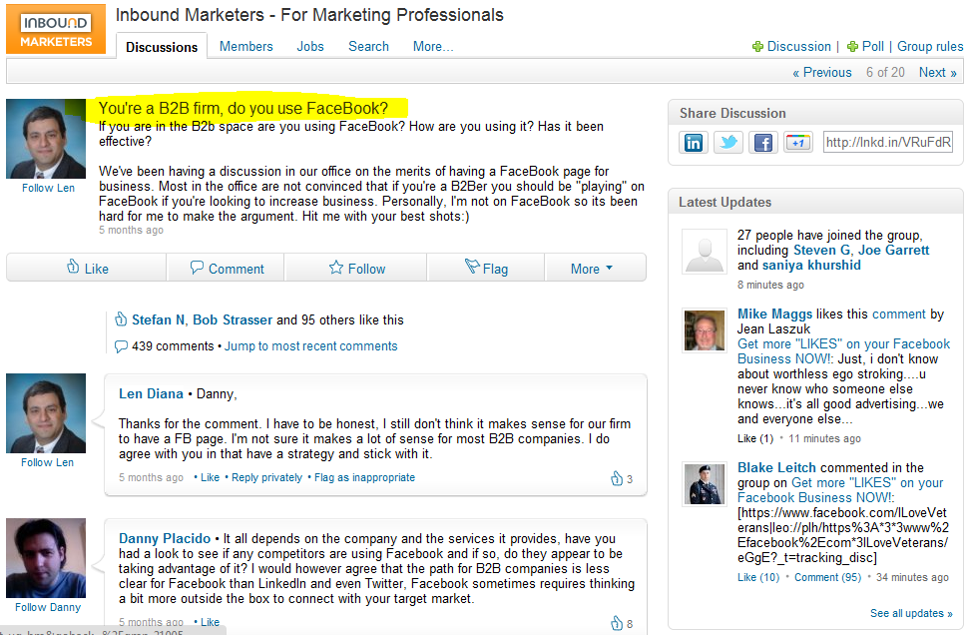
LinkedIn Groups
Notes:
Jeetu:
The other place to share your expertise is in LI’s Groups. You should be a member of the HubSpot Inbound Marketing group. You should join other groups where your prospects may be hanging out. Always, think back to your ideal prospect statement. For example, we came up with “Target B2B clients in the software, technology, and infrastructure space”. So you should go join groups around those specific markets. You may not be an expert with software but you are an expert with solving their pain around marketing and lead generation.

Slide 38
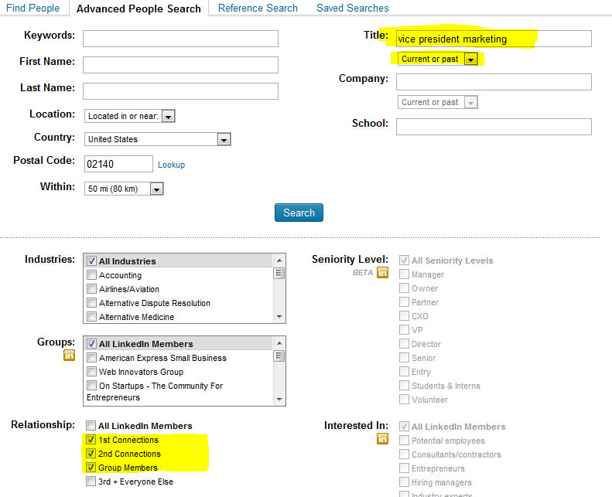
LinkedIn People Search
Notes:
Jeetu:
Another interesting place on LI is the People search. If you notice in the top right corner is a Search box. Most people just use the default search but there is an option to access an Advanced Search feature specifically the People Advanced Search. This is what you see when you are in the Advanced People Search. I am interesting in finding people who have the current or past title of vice president marketing and in a 50 miles radius around the zip code 02140 which is one of the zip codes for Cambridge. I am interested in everyone who is either 1 connection or 2 connections away from me.

Slide 39
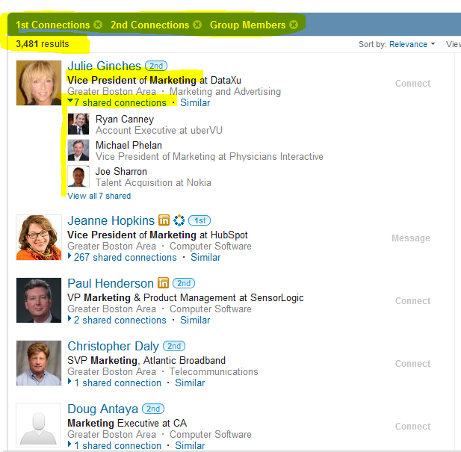
LinkedIn People Search - Results
Notes:
Jeetu:
A search shows 3481 people who match that criteria and this is again in a 50 mile radius around me. Now the reason I selected 1 or 2 connections away from me is because I am not going to approach these individuals directly but rather use my LI network to find out who is connected to them and who has a warm connection. For example, with Julie I have 7 connections in my network who are connected with Julie. I know Ryan and Joe very well and I might drop them a note saying something on the lines of “Joe, I noticed you are connected with Julie at DataXu. Do you feel comfortable introducing me to Julie?”

Slide 40
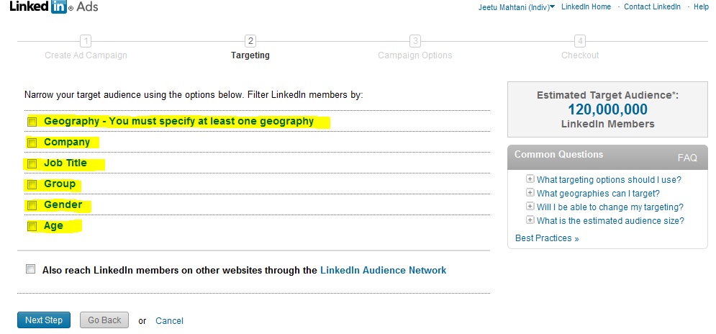
LinkedIn Direct Ads
Notes:
Jeetu:
A search shows 3481 people who match that criteria and this is again in a 50 mile radius around me. Now the reason I selected 1 or 2 connections away from me is because I am not going to approach these individuals directly but rather use my LI network to find out who is connected to them and who has a warm connection. For example, with Julie I have 7 connections in my network who are connected with Julie. I know Ryan and Joe very well and I might drop them a note saying something on the lines of “Joe, I noticed you are connected with Julie at DataXu. Do you feel comfortable introducing me to Julie?”

Slide 41
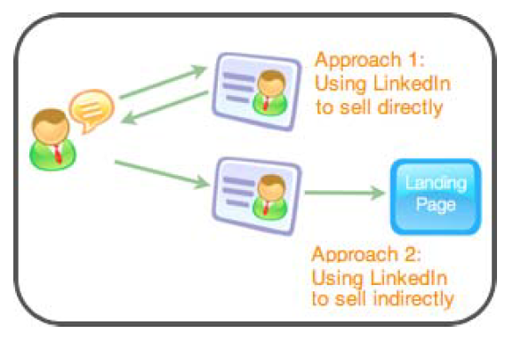
LinkedIn – Take-Aways
Sell Indirectly by Being an Advisor on LinkedIn - Share Great Content
Keep your Targeting Statement in mind when participating, interacting, and sharing
Notes:
Jeetu:
So to recap, when using LinkedIn you want to use it indirectly by being an advisor. Basically, you are leaving your advice and insight on LI and people will see that you are not selling but rather solving their problems and their pain. They will automatically come to you by checking your profile out and out your site. If you have CTAs and LPs on your site, then they will convert into leads. When you give feedback and share content, you will probably send them to a blog post where you share more detailed feedback. In the blog, you will have a Call to Action and that will take them down a conversion path towards becoming a lead.

Slide 42
Key Take-Aways and Homework
5
Notes:
Corey:
So everyone knows we love working closely with you guys and often times that does involve some homework. As we wind down let’s talk about the things you need to do this week to be successful this week in terms of your lead generation efforts.

Slide 43
Your success in sales is driven by
Activity
Process
Skills
Notes:
Jeetu:
There’s really no substitute for activity, process and skills can be taught and will be two things you’ll learn during this webinar series, but activity is the number 1 best thing you can do for your business when it comes to leads and lead generation.

Slide 44
Create your Ideal Prospect sentence
Start participating in LinkedIn
Continue implementing the Inbound tactics as part of your product consulting
Launch CTAs and Landing Pages using the eBooks we are letting Partners co-brand
Setup time with your Channel Account Manager (CAM) to review your Ideal Prospect sentence
Notes:
Jeetu

Slide 45

Tuesday, January 24
11 AM US EST
Next Topic – “Researching
Leads and Prospecting”

Slide 46
Questions?

