Slide 1
Researching Leads and Prospecting
Notes:
Jeetu:
Welcome to the second session of the Partner Program training webinar series for marketing agencies and independent marketing professionals.
My name is Jeetu Mahtani and I am joined by Corey Beale. We are both Partner Channel Managers at HubSpot.
Corey:
We partner with marketing agencies of all kinds to help agencies more cost-effectively and more efficiently provide a broader set of inbound marketing and demand generation services to our mutual customers.
Working with our partners, one of the biggest challenges that they have is adapting to a world where clients are asking for one agency that can do everything. The worlds of PR, advertising, marketing, seo, ppc, social media and web design and development are merging. And the feedback I’m getting from many types of agencies is that it’s really hard to do everything, deliver an ROI to clients and grow their agency at the same time.
That’s what HubSpot is helping partners with in many ways. Today, though, we’re going to talk about a framework for diagnosing the complete inbound marketing needs of a prospect or client. We’re going to provide you with a script and a playbook with how we’ve done this for about 10,000 companies.

Slide 2



Nice to Meet You
Jeetu Mahtani
HubSpot Sales Manager
http://www.linkedin.com/in/jeetumahtani
jmahtani@hubspot.com
Corey Beale
Hubspot Sales Manager
www.linkedin.com/in/coreybeale
cbeale@hubspot.com
Hash Tag: #AgencyTransform
Notes:
Corey:
We want to keep these sessions interactive both during and after the webinar. Feel free to reach out to either of us via email or LinkedIn and let’s get Twitter rocking today by using the hash tag #AgencyTransform

Slide 3

Notes:
Corey:
We are going to repeat this just one more time. Before we dive right in to the agenda there are a few quick house keeping notes we should make about today’s session.

Slide 4
Bookmark this Page!!
http://www.hubspot.com/advanced-sales-training-home
Notes:
Corey:
Make sure to keep this handy, each week we’ll be uploading the recording and slides to this URL

Slide 5

Notes:
Corey:
The first is that this session is being recorded and we’ll be emailing you a link to the recording by the end of the day. If you have colleagues or partners who were unable to attend today, definitely have them watch the recording prior to the session next week. Please post any questions into the chat pane and we’ll answer any questions towards the end.

Slide 6
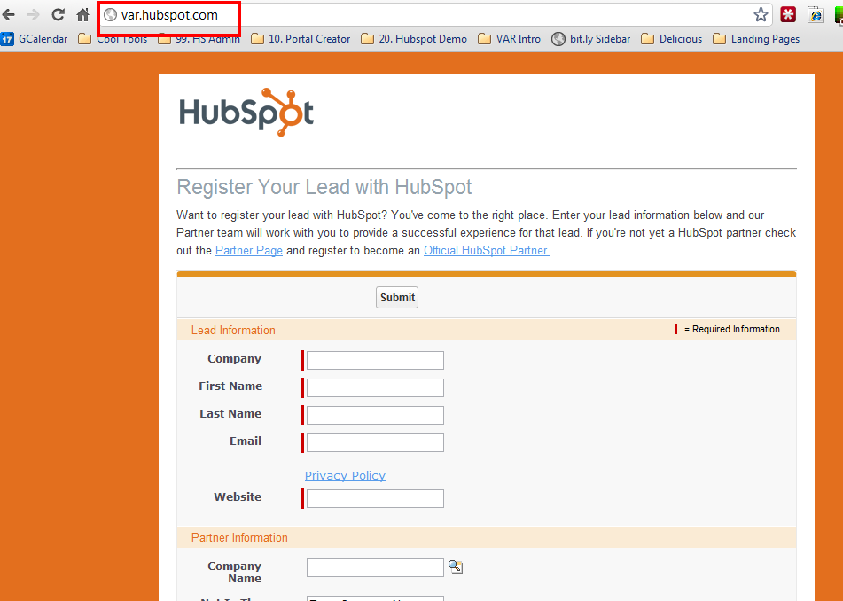
Notes:
Corey:
Register your leads, as often as possible and as many as possible. This will help your channel account manager focus the time you spend together and help coach you through to achieve some big wins on these accounts.

Slide 7
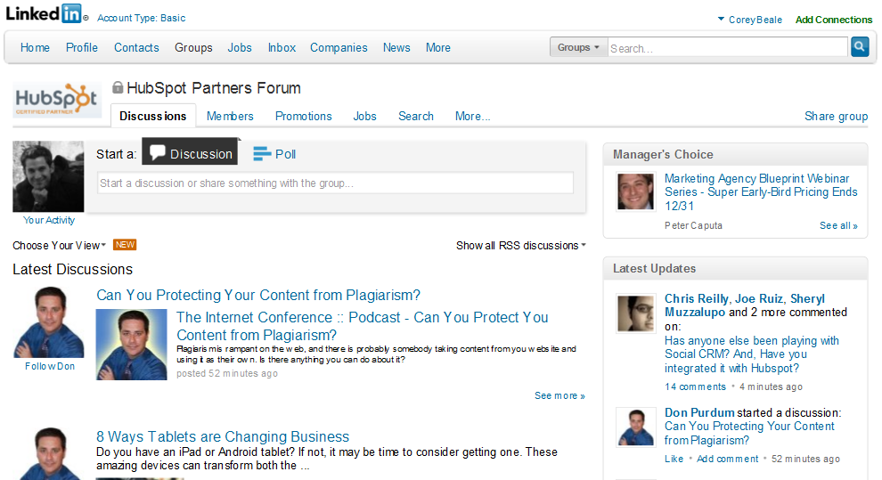
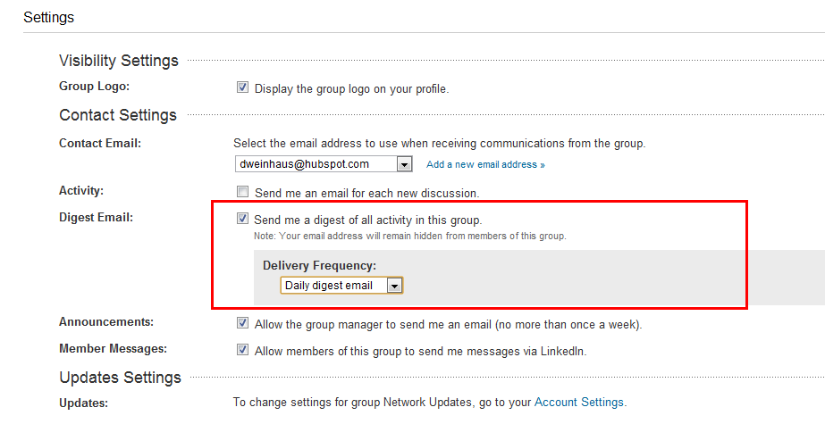
Notes:
Corey:
If you haven’t already make sure you have joined the LinkedIn Group “HubSpot Partners Forum” and make sure to setup the email settings for a daily digest of all activity in the group so you don’t miss anything to help you sell better, move quicker and network easier.

Slide 8
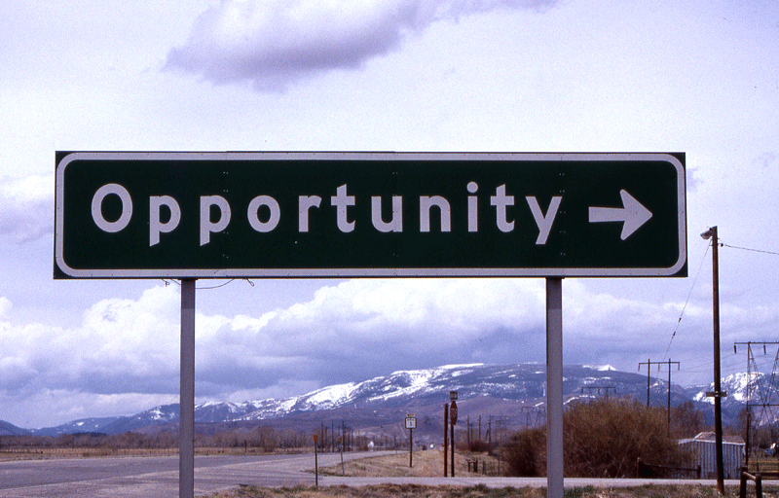
Notes:
Corey:
If you have an opportunity in play right now that you are working be sure to schedule time with your Channel Account Manager asap. He/she will help you determine the best ways to approach next steps and what items you’ll need to be successful.

Slide 9
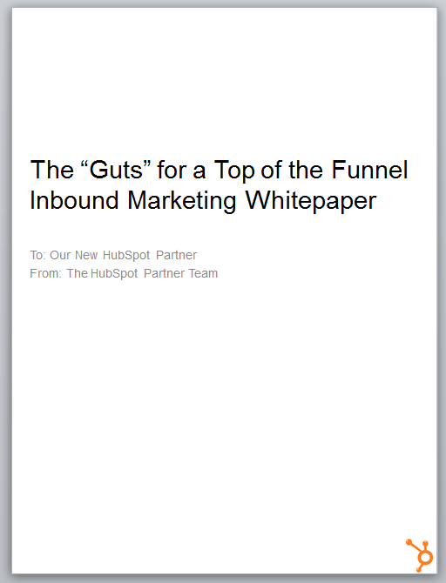

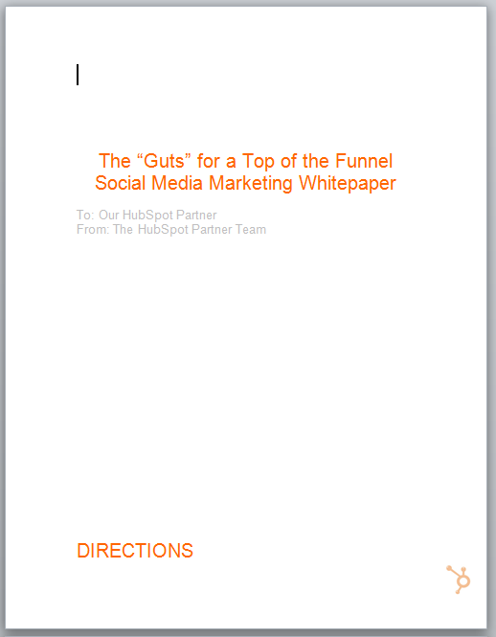
Notes:
Corey:
Since we’re talking about leads today I wanted to throw in a friendly reminder to get your eBooks start using them on your website TODAY to start generating inbound leads ☺

Slide 10
AGENDA
1
Recap: The recommended sales process
2
Effectively researching your leads
3
Prospecting tips and techniques
4
Prospecting do’s and don’ts
5
Key Take-Aways
Notes:
Jeetu:
Here’s an overview of what we’re going to talk about today. The big topic is around researching your leads and then prospecting. We are going to discuss a couple of approaches for researching your leads, makes notes and logging activities in your CRM, and then prospecting. We’ll share with you’re a few prospecting tips and techniques including do’s and don’t when you are prospecting.

Slide 11
The Recommended Sales Process & Methodology
1
Notes:
Jeeut:
So lets do a quick recap of the sales process.

Slide 12
Generating Leads
Researching Leads and Prospecting
Connecting and Qualifying
Inbound Marketing Assessment (IMA)
Diagnostic and Goal Setting
Present Solution
Contract and Close
Notes:
Jeetu:
So here is the sales process we shared with you in our last session. We focused on Generating Leads in the last session. Todays session is focused on Researching Leads and Prospecting. To recap the sales process, once you have leads, you will research them, pick up the phone and make that call. If you are unable to connect with them, you are going to send them a sequence of emails and also leave voicemails for them. Today we are going to share with you sample email and voicemail scripts. Once you do connect with the prospect, you are going to deliver your message like a movie star! We are going to share with you a Connect Playbook which will comprise of sound bites, objections to expect, and your goal for the next step. This is when you start your initial qualification. Following the connect, you are going to have a scheduled call during which you are going to continue your qualification by executing on an Inbound Marketing Assessment also known as an IMA. At the end of the IMA, you should have “trusted advisor” status and do an inoffensive close during which your prospect agrees they need your help and would like to define their marketing goals with you. Following the diagnostic and goal setting call, you are going to share the solution to hit their goals. Finally a contract and closing out the deal.

Slide 13



Inbound Marketing Sales Methodology
1. Lead Gen
Find Prospects to Call On
2. Research and Prospect
Get to a Connect
Lead
3. Connect
Schedule the Assessment
4. QUALIFY
Determine worthiness for next step
OPPORTUNITY
5. Diagnostic & Goal Setting
Align business goals with activities
6. Presentation & Experimentation
Present Solution and/or Trial
7. Contract & Close
Agree to Proceed
Notes:
Corey:
Friendly reminder, here at HubSpot every time we get a new sales employee we have them print this slide out and put it on their desk. We’re advising you do the same for your office or home office. It’s critically important not to skip steps in the methodology and follow them to a tee. It will ensure you are bringing the right people forward.

Slide 14
Effectively Researching Your Leads
2
Notes:
Corey:

Slide 15
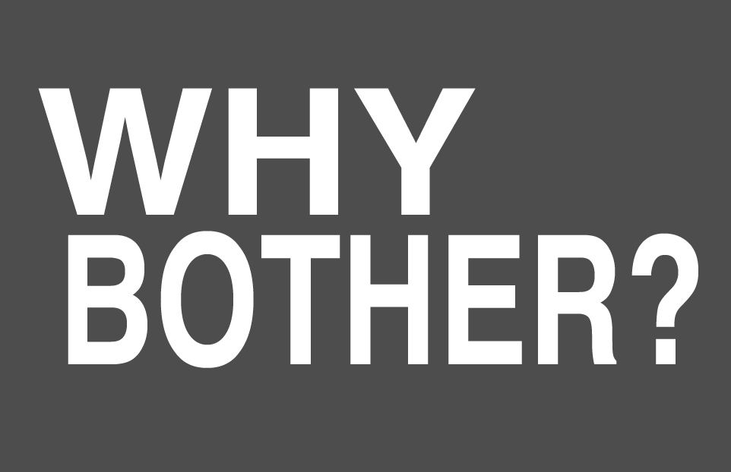
Notes:
Leverage as part of Rapport building
Show that you have researched the business and industry
Ask for a referral (if you have a common connection)
Genuinely interested in learning more about them
You are not here to sell them something but rather be a problem solver and trusted advisor

Slide 16
What you’re looking to accomplish
Determine if the lead is workable
Set your priority (High/Med/Low)
Start to qualify the lead (BANT/GPCT)
Determine their IM sophistication
Find opportunities to develop a connection
  Personalization
  Rapport building
  Trust development
Notes:
Jeetu:
The goal of the research stage is to be prepared for the Prospect, Connect, and Qualify stages of the sales process. This includes:
Determine whether the lead is workable and, if so, the priority of the lead (High/Med/Low)
Begin to understand the qualification of the lead to purchase your services
Understand the company and contact’s sophistication with inbound marketing
Identify opportunities for personalization, trust development, rapport building

Slide 17
Things to keep in mind
You work the company not the contact
Initial research should take 5 minutes
Next attempt pre-call review…5 minutes
If you have a CRM or lead tracking system log your notes
  Title your activity: Research
Notes:
Jeetu:
A lead is a company, not just a contact. It is important to work the company.
Researching a lead prior to the first attempt should take 5 minutes or less. Follow on attempts should be a 5 minute review of the notes captured during the initial research.
Capture all notes in the Activity section of your CRM. Add an Activity titled “Research

Slide 18
“Get prepared for the Prospect, Connect and Qualify stages of the sales process.”
Notes:
Corey:
So in a nutshell, your overall goal is to get prepared for the Prospect, Connect and Qualify stages of the sales process.

Slide 19

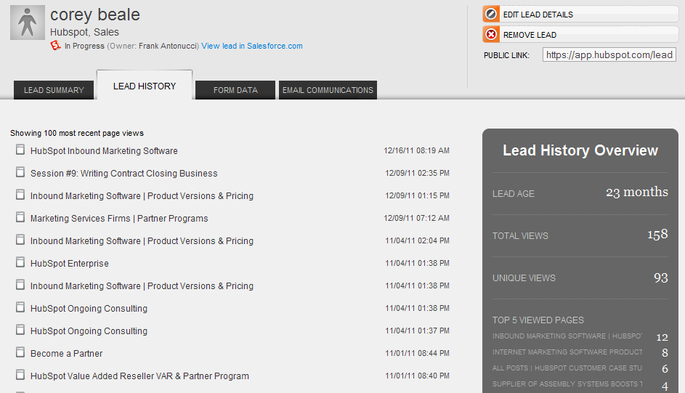

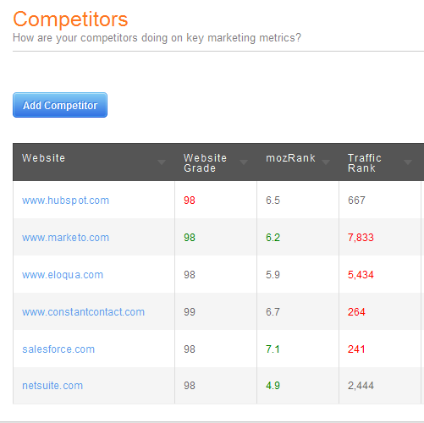


Notes:
Jeetu:
There are a couple of ways you can research your leads including HubSpot own Marketing Grader, your Lead Intelligence functionality in HubSpot. We are going to talk about using LinkedIn, Twitter, and also surprisingly Facebook for research.

Slide 20
LinkedIn
Review “Leveraging Social Media – Special Section” – Covered Lead Generation with LinkedIn
Study your Prospects LinkedIn Profile
  What is their current Title?
  How long have they been at the company?
  Do you have a common connection?
  What commonality exists between the two of you?
Make notes in your Customer Relationship Management (CRM) system
Notes:
Jeetu:
In our last session, we discussed the usage of LinkedIn to generate leads. Once you have a lead, go to LinkedIn and do a search on your prospect’s name. Once you find them in the search results, go to their full LinkedIn profile. Once you see their full LinkedIn profile, you can start building some intelligence around their current Title, how long have they been at the company. When you look at their Profile, you can also identify any common connections between them and you. So we’ve all seen a LinkedIn profile. Lets point out these key areas to pay closer attention to.

Slide 21
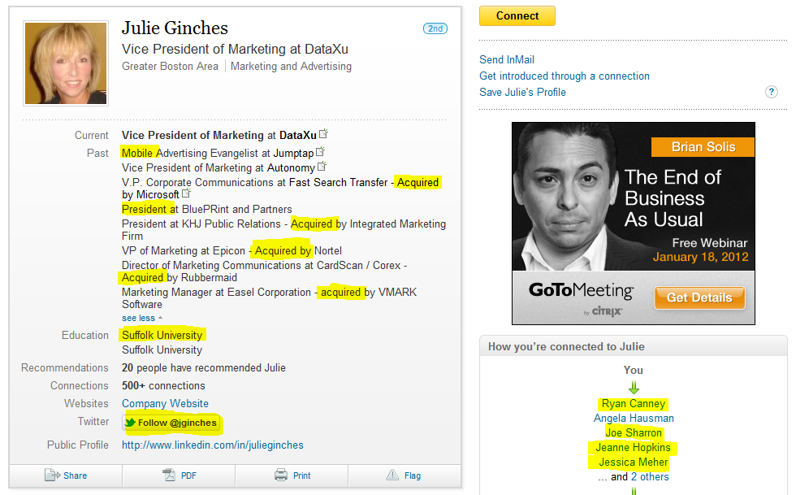
Notes:
Jeetu:
So again, once on their full LinkedIn profile, you can quickly answer key questions and start identifying trends. For example,
What is their current Title?
How long have they been at the company?
Do you have a common connection?
What commonality exists between the two of you?
You can start identifying trends. In the case of Julie’s LinkedIn Profile, I can see that she has been part of many acquisitions and she is probably used to change, has worked with many different vendors, and probably is a pretty advanced marketing person. She probably is more of a strategic marketing person who is heavily ROI and results driven. Been a senior marketer, she probably has been every imaginable marketing services provider so you want to be careful on how you position yourself when you do connect with her. We’ll share with you positioning statements in our next session that you will be able to leverage.

Slide 22
Twitter
Understand what interests them – hobbies, business issues/challenges, etc
What questions are they asking (issues/challenges)? What questions have they answered (expertise)?
Researching your prospect’s industry/market. Are there any trends? What are people talking about?
Leverage search.twitter.com
Make notes in your Customer Relationship Management (CRM) system
Notes:
Jeetu:
Many people discount Twitter but we at HubSpot see it as an excellent person, market, and industry research tool. Unlike LinkedIn, which is heavy business focused, Twitter can give you insights into their personal interests, their hobbies, and what burning questions and issues they are they dealing with. Your prospect is asking questions on Twitter or possibly also answering other member questions.
Other ways you can use Twitter include understanding what your competition is up to. You can go to search.twitter.com and enter your competitor and it will list what questions they are asking and who are interacting with them.
You can also do localized search on twitter. For example, you are looking to find prospects who are in healthcare and in Boston. You can go to search.twitter.com and enter “healthcare Boston” and you can find people in the Boston area who specialize in healthcare.

Slide 23
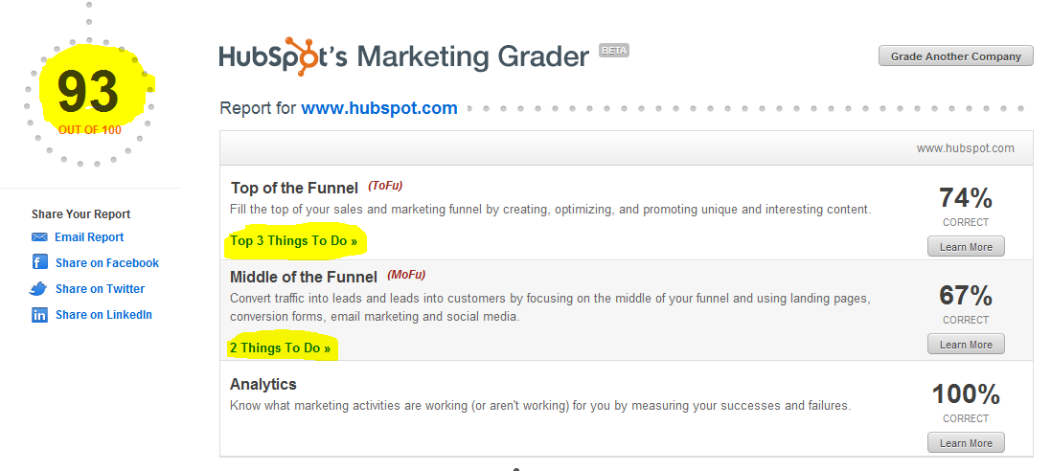
Marketing Grader
http://www.hubspot.tv/hubspot-partners/bid/112008/Using-Marketing-Grader-to-Sell-your-Inbound-Strategies
Notes:
Corey:
Another tool for research your prospect’s website is by using Marketing Grader. Go to grader.hubspot.com and enter your prospects website and also their competition. Marketing Grader will give you recommendations for your prospect’s website which you can leverage as part of the discussion with your prospect. When you do connect with your prospect on the phone, before you can start qualifying them by asking them tough question, you do want to give them advice that shows that you are not trying to sell them but rather solve their problems. You can use the recommendations from the Marketing Grader as part of giving them advice. The Marketing Grader also tells you what your prospect’s competition is up to and how your prospect stacks up against them. We have done a complete partner webinar on using Marketing Grader to sell Inbound Marketing strategies.
http://www.hubspot.tv/hubspot-partners/bid/112008/Using-Marketing-Grader-to-Sell-your-Inbound-Strategies

Slide 24
HubSpot Lead Intelligence
What pages have they seen?
What content have they downloaded?
  Note any trends
Social Media Intelligence
Custom Lead Grade
(Professional or Enterprise Only)
Notes:
Corey:
The other obvious place since I assume everyone on this call is using HubSpot is to use HubSpot’s Lead Intelligence. It probably is the first place to start your research. To recap using HubSpot’s Lead Intelligence, you can answer questions such as –
What pages have they seen?
What content have they downloaded?
Note any trends
Social Media Intelligence
Custom Lead Grade

Slide 25
HubSpot Competitors Report
Notes:
Corey:
In one of our sessions, we are going to talk about doing an Inbound Marketing Assessment also known as an IMA. The IMA uses a HubSpot Trial Portal in which you can access our Competition tool. Using the Competition tool, you can quickly compare a prospect’s website against 10 other company website…basically your prospect’s competition. By using this report, you can quickly compare your prospect and their competition across several metrics like how well their website is doing against the competition, traffic rank, etc

Slide 26
Prospecting Tips and Techniques
3
Notes:
Corey:
Ok let’s dive in to some actual techniques you can use and some special tips we leverage here at HubSpot.

Slide 27
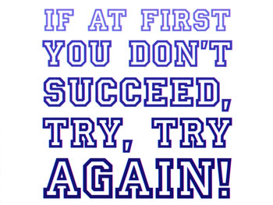
Notes:
Corey:
As Jeetu closed with in our last session, nothing beats activity. When it comes to research and prospecting nothing beats activity and nothing is more important than regardless of the call outcome, take a lesson and move on to the next one.

Slide 28
Activities to Avoid Prospecting | That’s Me | My “Real” Fear or Discomfort
Read the paper
Call an existing client | X | Hate cold-calling / Hate speaking to someone I don’t know
Perform non-crucial paperwork
Surf the internet
Rewrite your sales pipeline
Go to the rest room
Attend this webinar ☺
Friend Jeetu on Facebook
Hunting LinkedIn Randomly
Notes:
Jeetu:
What comes in the way of Prospecting? This is in no ways meant to point anyone specific. Each of us have bad habits. Both Corey and I too have bad habits and behaviors when it comes to sales. The only way to fix these bad behaviors is to accept there is a problem. So what are some of these classic behaviors that come in our way of prospecting. Some classic behaviors include reading the paper or going to Google News. Another behavior would be to call an existing client instead of following up on all your new leads….
Now you should print this slide out, and mark out areas that apply to you. In almost all cases, what you see in column 1 is not the real problem but rather there is an underlying fear or discomfort that is causing you to do something that is avoids prospecting (move to next slide).

Slide 29

Notes:
Jeetu:
For example, if you call an existing client instead of prospecting against your new leads, in many cases the real fear or discomfort is around hating cold calls and hating to speak to an unknown person. Now if we dig deeper into why we hate cold calls, it is possible we hate it because we don’t have a system we can count on for prospecting. A system might include a script that you use when you connect with a prospect on the phone; a list of questions that you ask your prospect; a framework that helps you qualify your prospect on Budget, Authority, Need, and Timing. Now all these elements including a script to use when you connect with a prospect, questions you ask to qualify your prospect, and a framework to determine a go- or no-go with a prospect is something we are going to be sharing with you as part of these training sessions.

Slide 30

Notes:
Jeetu:
I am sure all of us are eager to get going with prospecting but there is one thing we need to do before prospecting. We need to come with our positioning statement. Your positioning statement is the foundation for your Connect call. We need to do this now, so in our next session, you can take your Positioning Statement and nicely integrate it into the Connect script that we are going to share with you. So Corey can you take us through what positioning is all about.
Corey
It’s all about positioning and in particular positioning statements. Remember when we used these early on with you guys? You’re all here now so obviously they work when well thought out ☺

Slide 31
What are Positioning Statements?
Continues your Ideal Client Session Theme
  Review Session 1 Recording
Positioning Statements help you uncover business and personal problems
Relate your understanding to the Prospect’s industry and pain → Shows understanding
Get them to talk!
Notes:
Corey:
Purpose is to connect with the owner. They should at the end say, wow that’ me. The who, what they are feeling, and the challenge.
It should also be valuable to you. You should pick a positioning statement where if it doesn’t resonate, its not a good prospect for you anyway.

Slide 32
Positioning Statement Framework – Example 1
We help <companies like yours>… (title)
Who are struggling with (OR: frustrated because, unhappy that; emotional word)
about <insert up to 3 probable problems>
  They’re not growing as fast as they want.
  Losing marketshare to competitors.
  They spent a lot of $ on their website, but aren’t generating an ROI.
Do you face any of these challenges?
Notes:
Jeetu:
So the framework for creating a Position Statement is something like. We help (titles) of (companies) who are (frustrated) with (issues). Do you face any of these challenges?

Slide 33
Another Example
We help <companies like yours>…
Who are struggling with (OR: frustrated because, unhappy that)
<insert up to 3 probable problems>
  They have spent money.
  On different activities – SEO, Adwords,etc
  But not getting the leads or return they had hoped for.
Are you seeing similar trends??
Notes:
Jeetu:
…

Slide 34
Sample Positioning Statement
I help marketers like you who are frustrated that they’ve spent a lot of time and money working to please the sales team with high quality leads that close faster, but they have yet to see the quality leads they expected from their website and online marketing efforts. Typically they’ve hired an outside agency to do the work, purchased lists or gone to tradeshows in order to achieve their goals and they aren’t seeing the results so upper management and the sales team are concerned. Are you experiencing similar challenges?
Notes:
Corey:
Purpose is to connect with the owner. They should at the end say, wow that’ me. The who, what they are feeling, and the challenge.
It should also be valuable to you. You should pick a positioning statement where if it doesn’t resonate, its not a good prospect for you anyway.
So, not so broad as ‘who are frustrated they aren’t making more money’. Like a little more specific.
These are what we have our reps hang over their desk and look at before every call. They look at a website and their lead research as well as what we know about companies of that size or type and think about which one of these might be most appropriate for this type of company?
Does anyone currently use a positioning statement in a similar format?

Slide 35
Ready to Start Prospecting
Done Researching. Schedule time in your calendar to Prospect.
Pick up the Phone and Dial!
Your Goal for Prospecting is to get to a Connect (speaking to the DM on
the phone)
While you work towards a Connect,
you will use a combination between
Vmail and Email
Notes:
Corey:
Now in a perfect world you’d connect with a DM every time you pick up the phone. The unfortunate reality is that you need a game plan to back you up should you get an answering machine. The way to be effective here is with a combination of vmail and email, a sequence that has different impact and messages for each time you leave a vm/email.

Slide 36
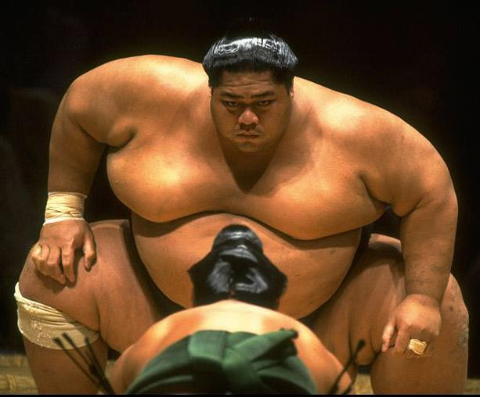
Prospecting BASHO style
Notes:
Corey:
Who’s who here?
The prospect is actually the big guy and you are the little guy. Despite the size differences you can still win! You will use BASHO to wear them down and gain leverage on them over time to eventually topple them over and then give you a call back.

Slide 37
Attempting to Connect – Basho Sequence
Voicemail, Email
  <Wait for 24 hours>
Voicemail, Email
  <Wait for 48 hours>
Voicemail, Email
  <Wait for 72 hours>
Voicemail, Email
  <Wait for 5 days>
Breakup Voicemail, Email
Notes:
Corey:
We tweak this a lot internally here, but the above is a pretty well agreed upon sequence of events when prospecting.

Slide 38
BASHO Voicemail 1
Prospect,
You recently downloaded our eBook “Lean Mean Traffic Generating Machine: 7 tools to make your website better”. You also mentioned your biggest marketing challenge is “lead generation and ROI”.
Based on working with other software companies like yours, I believe you'd benefit from our lead generation programs.
Please let me know when you have a few minutes to connect. My name is ____ and I'm calling from <Agency>. 857-829-5536.
Thank you.
Notes:
Jeetu:
So here is an example of Basho Voicemail 1. Your email with follow a similar theme. (Jeetu reads it). There are a couple of elements we emphasize in this message. NOTE you’ll see we have the word “You” highlighted here, that’s the BASHO approach it focuses on what they did or need not what you want.
For example…

Slide 39
BASHO Voicemail 2
Prospect,
You recently downloaded our eBook “Lean Mean Traffic Generating Machine: 7 tools to make your website better”. You also mentioned your biggest marketing challenge is “lead generation and ROI”.
Your company looks similar to many of our existing successful customers. While learning more about your company, I ran a report on your website that gives you a grade from 0 to 100 compared to the millions of other websites our software has evaluated. Your grade was ___.
Please let me know when you have a few minutes to connect. My name is ____, and I am calling with <Agency>. 857-829-5536.
Thank you.
Notes:
Corey:
(Corey reads it). There are a couple of elements we emphasize in this message. For example…

Slide 40
BASHO Voicemail 3
Prospect,
You recently downloaded our eBook “Lean Mean Traffic Generating Machine: 7 tools to make your website better”. You also mentioned your biggest marketing challenge is “lead generation and ROI”.
We've helped many our customers similar to your business expand and grow traffic, leads and customers from their website and marketing efforts.
I’d recommending visiting our website and initiating a free website assessment.
My name is _____, and I am calling with <Agency>. If you feel we can help, I can be reached at 857-829-5536.
Thank you.
Notes:
Jeetu:
(Jeetu reads it). There are a couple of elements we emphasize in this message. For example…

Slide 41
BASHO Voicemail 4
Prospect,
You recently downloaded our eBook “Lean Mean Traffic Generating Machine: 7 tools to make your website better”. You also mentioned your biggest marketing challenge is “lead generation and ROI”.
After you downloaded some of our free educational materials, I sent you several emails. I've reached out because it seems like we'd be able to help your business like we've helped other software companies.
Additionally, I pointed you to some free resources we've produced specifically to help software companies grow their sales.
Please let me know when you have a few minutes to connect. My name is ____, and I am calling with HubSpot. 857-829-5536.
Thank you.
Notes:
Corey:
(Corey reads it). There are a couple of elements we emphasize in this message. For example…

Slide 42

How to go negative when prospecting…
Notes:
Jeetu:
So you have had a sequence of 4 attempts, a total of 8 touches with voicemail and email. They haven’t called you back or replied to your email. What do you do at this point? You are going to breakup with the prospect by going negative.

Slide 43
BASHO Voicemail 5
Prospect,
You recently downloaded our eBook “Lean Mean Traffic Generating Machine: 7 tools to make your website better”. You seem very similar to other software companies we’ve helped with growing their business.
I wanted to reach out one last time today to follow up as I do have some suggestions on how to drive more leads through your website.
If I don’t hear back from you I’m going to assume the timing isn’t right and that you don't need our help with anything.
My name is ____, and I am calling with <Agency>. 857-829-5536.
Notes:
Jeetu:
(Jeetu reads it). There are a couple of elements we emphasize in this message. For example…

Slide 44
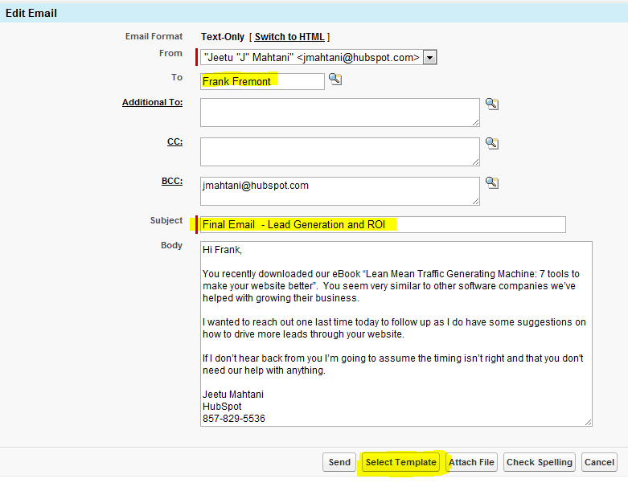
Notes:
Jeetu:
So those 5 example voicemail messages we shared with you is very similar to how you would configure your email templates. We use Salesforce.com as the CRM and we have these message in templates so all we have to do is click on “Select Template” and pick the appropriate template depending on our attempt.
Alternatively you can use GMAIL or Outlook as well to host your templates if you don’t have a CRM.

Slide 45
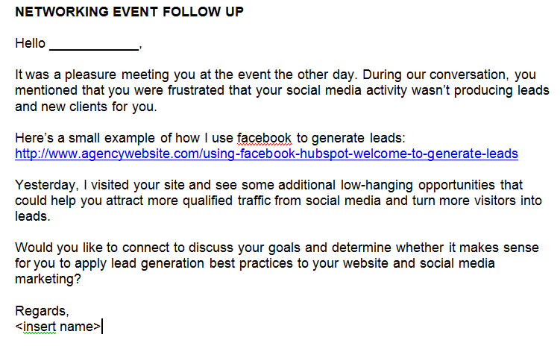
Connecting with Networking Leads (Email)
Notes:
Discuss how to do this via phone.

Slide 46

RATE your Leads!
Low
Medium
High
Notes:
Corey:
Here at HubSpot we rate our leads so we know how to better prioritize our time. We get thousands of leads a month so this is critical to us, but even if we only get 100s, this would still be critical so you could best understand ways to prioritize your prospecting time.

Slide 47
Lead Ratings
High:
  Great Fit
    Matches Ideal Prospect
    Lead Score > 70
  Marketing Challenge
  Decision Maker
  Common Connection via Social Media (eg. LinkedIn)
  High Repeat Activity on Website
Medium:
  Good Fit
    Matches some elements of Ideal Prospect
    Lead Score >=50 and <70
  Marketing Challenge
  Influencer
  Some Activity on Website
Low:
  No fit with Ideal Prospect
    No match with Ideal Prospect
    Lead Score <50
  1-2 Page visit on website
Notes:
Jeetu:
Lead Ratings…(use Slide)

Slide 48
How much effort based on rating?
High
  5 touch sequence (Vmail, Email repeated 5x)
Medium
  4 touch sequence (Vmail, Email repeated 4x)
Low
  1 to 2 touch sequences
  Continue with lead nurturing
  Monitor HubSpot lead visit alerts
Notes:
Corey:

Slide 49
Key Take-Aways
Dos and Don’ts
4
Notes:
Jeetu:
As we begin to close up let’s run through some DO’s and DONT’s based on today’s session.

Slide 50


Work the company not the contact
Better research yields better efficiency
Spend time with the right people
Work you high-rated leads hard
Keep great notes in your CRM
Take shortcuts
Make excuses for prospecting
Give up too early – 80% of all sales are made on the 5th contact
Try to remember your activity – log activity in your CRM
Ignore lead intelligence
Ignore lead rating
Notes:
Corey:
Dos and Don’t

Slide 51
Key Takeaways
1
Work the company not the contact
2
Invest in preparation for the sales process
3
Better research yields better efficiency
4
Spend time with the right people
5
Work you high-rated leads hard
6
Keep great notes in SFDC
Notes:
Corey:
Here are today’s big take-aways

Slide 52
Your success in sales is driven by
Activity
Process
Skills
Notes:
Corey:
We’re going to re-iterate this again this week. There’s really no substitute for activity, process and skills can be taught and will be two things you’ll learn during this webinar series, but activity is the number 1 best thing you can do for your business when it comes to leads and lead generation.

Slide 53
Stats, Quotes, and Homework
5
Notes:
Corey:
So everyone knows we love working closely with you guys and often times that does involve some homework. As we wind down let’s talk about the things you need to do this week to be successful this week in terms of your research and prospecting stages.
We’ve also added a few great quotes and stats to help guide you along as well.

Slide 54
5 ‘touches’ to finalize 80% of sales!
2% of sales are made on the 1st contact (touch). These are usually people who have already done their research and know exactly what they want
3% of sales are made on the 2nd contact
5% of sales are made on the 3rd contact
10% of sales are made on the 4th contact
80% of sales are made on the 5th contact
Notes:
Jeetu:
So as Corey shared, don’t skip steps. In general, 80% of sales are made on the 5th contact. (Jeetu)

Slide 55
"Winning is not everything, but the effort to win is." - Zig Ziglar
“Most of the important things in the world have been accomplished by people who have kept on trying when there seemed to be no hope at all.” – Dale Carnegie
"History has demonstrated that the most notable winners usually encountered heartbreaking obstacles before they triumphed. They won because they refused to become discouraged by their defeats." - Bertie C. Forbes
Notes:
Jeetu:
On a final notes, here are some of my favorite quotes.

Slide 56
Schedule time in your Calendar for Prospecting
Research the 25 leads you generated last week.
Create your Positioning Statement
Setup time with your Channel Account Manager (CAM) to review your research and Positioning Statement.
Implement the email scripts in your CRM or other source (GMAIL/Outlook etc)
Continue implementing the Inbound tactics as part of your product consulting.
Notes:
Corey:
Aaand to the fun part, here is today’s homework.

Slide 57

Tuesday, January 31
11 AM US EST
Next Topic – “Connecting
and Qualifying”

Slide 58
Questions?

