Slide 1
Inbound Marketing Assessment (aka IMA)
Notes:
David:
Welcome to the Partner Program training webinar series for marketing agencies and independent marketing professionals.
My name is David Weinhaus and I am joined by Corey Beale. We are both Partner Channel Managers at HubSpot.
Corey:
We partner with marketing agencies of all kinds to help agencies more cost-effectively and more efficiently provide a broader set of inbound marketing and demand generation services to our mutual customers.
Working with our partners, one of the biggest challenges that they have is adapting to a world where clients are asking for one agency that can do everything. The worlds of PR, advertising, marketing, seo, ppc, social media and web design and development are merging. And the feedback I’m getting from many types of agencies is that it’s really hard to do everything, deliver an ROI to clients and grow their agency at the same time.
That’s what HubSpot is helping partners with in many ways. Today, though, we’re going to talk about a framework for diagnosing the complete inbound marketing needs of a prospect or client. We’re going to provide you with a script and a playbook with how we’ve done this for about 10,000 companies.

Slide 2



Nice to Meet You
David Weinhaus
Partner Account Manager
www.linkedin.com/in/davidweinhaus
dweinhaus@hubspot.com
Corey Beale
Hubspot Sales Manager
www.linkedin.com/in/coreybeale
cbeale@hubspot.com
Hash Tag: #AgencyTransform
Notes:
Corey:
We want to keep these sessions interactive both during and after the webinar. Feel free to reach out to either of us via email or LinkedIn and let’s get Twitter rocking today by using the hash tag #AgencyTransform

Slide 3

Notes:
Corey:
Ok ok this is the last time I promise. Before we dive right in to the agenda there are a few quick house keeping notes we should make about today’s session.

Slide 4
Bookmark this Page!!
http://www.hubspot.com/advanced-sales-training-home
Notes:
Corey:
Make sure to keep this handy, each week we’ll be uploading the recording and slides to this URL

Slide 5
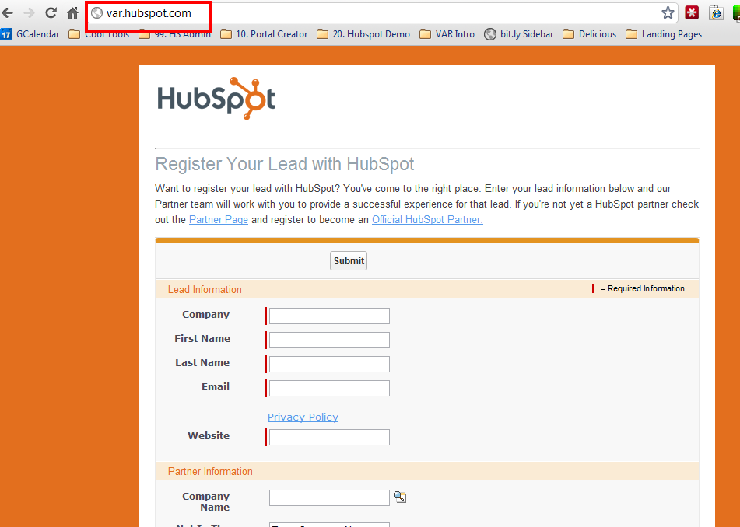



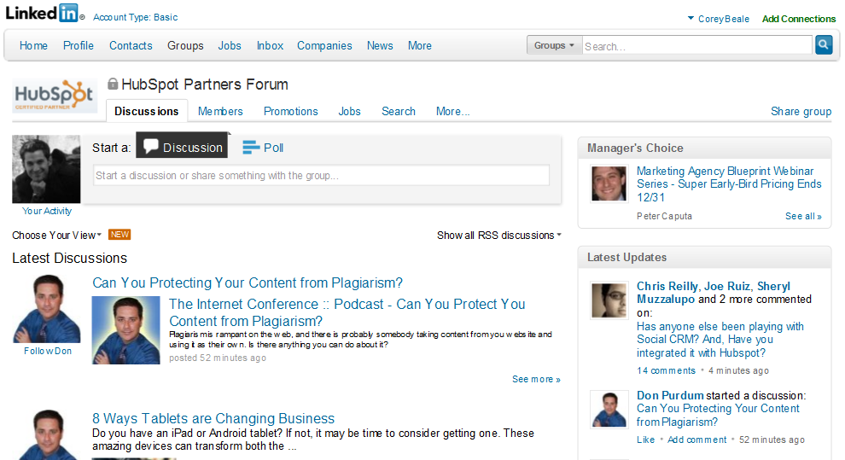
Notes:
Corey:
We’re recording
Register your leads, as often as possible and as many as possible.
Get your ebooks
Hang out with your CAM and discuss opportunities
Join the LinkedIn group!

Slide 6
AGENDA
1
Quick Recap: The recommended sales process
2
Special Section - ROLE PLAY!
3
Purpose of an IMA – What is It
4
The IMA Playbook for Partners – Guidelines
5
Potholes
6
Key-Takeaways
Notes:
David:
Here’s an overview of what we’re going to talk about today. The topic is around the Inbound Marketing Assessment. We’ll start with a quick re-cap about where we are in the sales process and where we are heading, talk briefly about some big things you need to consider and comprehend about the IMA, talk a little about what it is and the real purposes behind it. Then we’ll dive head first in to the IMA Playbook for VARs and the general guidelines of what an IMA looks like, talk a little about potholes, then proceed to explode Twitter with a special bonus section that will require everyone to follow along with their own printed version of the IMA Playbook.
We’ll cap it all off with key-takeaways and the weekly homework assignment.

Slide 7
The Recommended Sales Process & Methodology
1
Notes:
David:
So let’s get down to it and start talking about the HubSpot sales process and methodology.

Slide 8
Generating Leads
Researching Leads and Prospecting
Connecting and Qualifying
Inbound Marketing Assessment (IMA)
Diagnostic and Goal Setting
Present Solution
Contract and Close
Notes:
David:
So here is the sales process we shared with you in our last session. We focused on Connecting and Qualifying in the last session. Hopefully you have connected with a few leads, used your positioning statement, completed your pre-qualification and scheduled an IMA. Todays session is going to focus on executing an IMA and continuing the qualification process.
Following the connect, you are going to have a scheduled call during which you are going to continue your qualification by executing on an Inbound Marketing Assessment also known as an IMA. At the end of the IMA, you should have “trusted advisor” status and do an inoffensive close during which your prospect agrees they need your help and would like to define their marketing goals with you.

Slide 9


Inbound Marketing Sales Methodology
1. Generate Leads
Find Prospects to Call On
2. Research and Prospect
Get to a Connect
Lead
3. Connect
Schedule the Assessment
3. Qualify
Determine worthiness for next step
OPPORTUNITY
5. Diagnostic & Goal Setting
Align business goals with activities
6. Presentation & Experimentation
Present Solution and/or Trial
7. Contract & Close
Agree to Proceed
Notes:
David:
We’re moving nicely down the funnel and beginning to get in to the meat of the sales process in to the stages where your lead has really become more of an opportunity. I’m going to steal Corey’s thunder today and throw in the friendly reminder to print this out and hang it in your office to ensure you are not skipping necessary steps in the sales process to make you successful.

Slide 10
Let’s Do This
2
Notes:
David:
Now any sales process is going to have objections and pushbacks and we understand that. So to help outline these we have a little bonus for you!

Slide 11

Notes:
David:
Corey and I are going to role play an IMA. Between the two of us we’ve been on almost 1,000 of these so what we’ve done is compile some typical objections, attitudes etc that you’ll face and we’ll show you exactly how to work through it on the role play.

Slide 12
The Purpose of an IMA
3
Notes:
Corey:
Ok so let’s talk a little bit about the actual purpose of an IMA and what it’s really all about from your eyes.

Slide 13

What It Is
Notes:
Corey:
The IMA is a discovery call framed around the idea of a strategic business conversation in which you are attempting to gain an in-depth understanding of a prospect business goals, their plans to achieve those goal. What stands in their way to achieving those goals. And, the timeline in which they need to achieve them.
Before we get into it, I want to make sure you grasp the challenge that you’re facing.
You need to inspire and then manage a whole lotta change in a short period of time, don’t worry it’s totally achievable.
You need to tell your prospect that you’re going to rock their world. You’re going to ask them to make an investment in time and money. You’re going to ask them to reallocate funds and stop doing some of the stuff they’ve been doing for decades. You’re going to have to get sales and marketing in a room together and make them set goals that they agree to hold each other accountable to. You’re going to ask them to publish information that they’ve long used as a competitive advantage in 1:1 solution selling situations. You’re going to ask them to let people leave comments on their website and invite their prospects to connect with them on the same site where their college son talks about his fraternity parties.
This is a huge change. But, for many companies, it’s an absolute necessity.
And it’s our job to identify which companies need and are willing to change. Then, help them make the change.
Inbound Marketing Requires:
An investment in time
An investment in money
Willingness to change what’s worked for them during the last 4 decades.
Aligning sales and marketing
Changing marketing’s daily activities
Changing sale’s approach
Creating and publishing valuable content.
Giving away valuable information.
Letting people post comments on your website.
Responding to people on Facebook & Twitter…
Lots of other stuff that is scary and crazy!

Slide 14

What It Isn’t
Notes:
Corey:
It’s not a dog and pony show. It’s not about show up and throw up all this awesome free stuff you already know about their business based on analytical proof and intelligence. You are showing the tools, but you are most importantly tying the tool values back to their needs and tying-down the prospect at each stage of the game.

Slide 15
Why You Need To Do An IMA
Build Credibility & Trust
Qualify the Prospect
Advance the Sales Process
Notes:
David:
Overall, the objective to continue to advance the sales process (meaning you properly qualify this as someone to spend more time with), but it’s critical that the right approach is taken so you also build credibility and trust so that person is willing to divulge the right kind of information to you.
The IMA is framed as something for them, but it’s ultimately about you decided whom you want to work with and invest time in. Time is the number one enemy with this stuff, you need to be weary of that.
In your Connect you completed your pre-qualification. The IMA is framed as something for them, but really it’s about you making a decision on the information you were able to gather whether or not this prospect is worth more of your time
Your Job is to find the serious qualified prospects and move on from the others!

Slide 16

What Happens During It
Notes:
David:
Talk about trust that can occur and why it’s important

Slide 17
You Must Understand Their Goals & Challenges
Inbound Marketing Assessment:
A strategy for uncovering your prospect’s challenges and goals.
An opportunity to educate and inspire your prospect.
An opportunity to establish credibility and trust.
An opportunity to determine if they are qualified to be helped and you are qualified to help them.
Notes:
David:
The first and most critical step of helping a company implement and manage change is to first understand what is important to them.
You need to first uncover their goals, their dreams, their constraints, their problems.
People don’t change unless they need to. And while it’s very logical to us that they should embrace inbound marketing, they’re not going to do it unless you help them connect how they can overcome their problems and achieve their goals with the inbound marketing solution you’re proposing.
The framework we’ve developed at HubSpot for this process is called ‘The Inbound Marketing Assessment”.

Slide 18
Notes:
David:
So we’re going to role play again to showcase the next stage of the IMA. We’ve set the initial agenda and I’ve gotten Corey talking, what’s important now is to dig in to his GPCT.
REVIEW BANT

Slide 19
What Happens During It – The Buyer/Seller Dance
What They Want to Know:
How much does it cost?
What problems can you help me solve?
How does it work?
What goals can you help me achieve?
How long does it take?
Do I have to do work?
Can they do this by the time I need it?
What You Need to Know:
Will they invest time/money?
What services do they need?
What HubSpot product, features and services do they need?
Are they motivated to change?
Are they committed for the long haul?
Can they create content?
When do they want/need to start?
You Share Expertise
Win-Win
Prospect Shares Info
Notes:
Corey:
In any sales situation, both the buyer and the seller are constantly trying to evaluate whether they should continue talking to each other, regardless of the framework around the IMA the same dance still applies.
After many IMAs, you (or they) may decide that it’s not worth talking anymore. That’s ok. There’s plenty of companies that can use this stuff.
There’s certain things that they want to know and that you want to know. Usually, these are pretty well aligned. Buyers and sellers just ask the questions in different ways and often at different times. You will be much more effective if you ask the questions early and in your way. That’s what the IMA is.
For example…. A prospect might ask you, “How much is this going to cost?” Before they ask that, you want to ask them, “How much time and money can you invest in your online lead generation efforts?” A prospect might ask, “How long will it take for this stuff to start working?”. You should have asked, “This process usually requires a long term commitment. Will you be able to commit to this for the long haul? At what point do you need this to start producing leads?”
If you ask these questions and have discussions with your prospect, you’ll be helping them understand the process just as much as you’ll be helping yourself figure out whether this is a good opportunity or not.

Slide 20

You can Deliver the Solution to their Problems
NOT SALES PERSON!
(If they are a fit)
Notes:
Corey:
Approach sales and the IMA as problem solving – not convincing somebody of something. Do they have a problem, are they serious about fixing it, what do they need to do to fix it -> are you the right one to help
You can solve their problems! If they are the fit, go into this with 100% confidence that that is the case, remember you are the expert at this stuff
And if you don’t feel that way….take your confidence from the fact that
You have got this entire company and incredible community behind you that you will tap into
-You work with a software, methodology, and philosophy that works.
-if you doubt what you can deliver, go watch case studies, every night before you go to bed

Slide 21


Weak Pipeline and Little Development
Strong Pipeline and/or Doing What it Takes to Build One
“This job could be really important. How am I going to get some business?”
“I’m going to impress them”
“I hope my tough questions don’t rub them the wrong way”
“Are they a serious prospect? Do they have budget?”
“They need to be willing to answer my tough questions”
“If not these guys, there are plenty more companies that need my help”
Notes:
Corey:
Having a strong pipeline is crucial to actually being successful in your IMA’s. If you have a strong pipeline you will have more confidence to say no and avoid becoming emotionally involved in the meeting. Remember a NO is ok, it’s the maybe’s that aren’t.
By doing so you’ll build a stronger overall pipe that gathers momentum on itself and allows you to be choosey about the prospects you bring through your sales process, creating a scenario where only the best have come through.
If you are going to fail at this stage, fail quickly. Of all the stages in the sales process it’s the most important for you to become an expert at.

Slide 22
The IMA Playbook for Partners/VARs
4
Notes:
Corey:
Alright so let’s actually dive in to this badboy

Slide 23
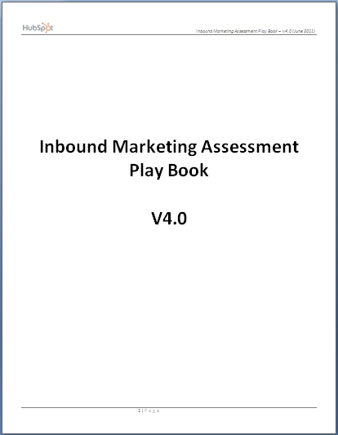
Intro to the IMA Play Book
Call Flow and General Guidelines
Sounds Bites and Key Questions
BANT
GPCT
IMA Tools
Competitors Report
Tips Sheet
Notes:
Corey:
So here’s what you’ll find within the playbook (talk to the slide)

Slide 24
What It Helps You Achieve
BANT
Notes:
David:
To qualify that the prospect is WORTH YOUR TIME to pursue!
Prospects will take free information with no intent or ability to buy.

Slide 25




What It Helps You Achieve
Notes:
David:
Talk about GPCT and potential to add another C on there for consequences

Slide 26
Typical IMA Flow
Build Rapport – Get the prospect at ease, start to build trust.
Set the Agenda – Establish exactly what will take place during the call.
Competitors Tab within the HubSpot Portal
Warm Up/Big Picture – Get prospect talking about their business.
Goals – What is this business setting out to accomplish?
Plans – What plans are in place to get there?
Challenges – What stands in their way to hitting their goals?
Timelines – How soon do they need to execute to hit their goals?
Expose Consequences and Implications – What if they hit? What if they miss?
Verify Budget and Authority – Can they afford it? Can they make a purchase decision?
Important Note: Provide specific tips over the course of the call to demonstrate knowledge, build credibility and gain trust to allow you to dig deeper into your prospect’s business.
Close for Next Steps – Diagnostic Call
Notes:
Corey:
The typical flow for an IMA is the following. (read through slide)
What most agencies do is have a quick call and then start talking about how their agency is better and different. Most prospects do NOT care about you. You’ll note not once on here do you see talk about your own company. ☺
They care much more about them. Their goals. This framework gives you an opportunity to listen to them.
There’s a funny thing that happens when salespeople stop talking, ask questions, listen and then have natural conversations. Sales professionals that can do this are perceived as the most credible, trustworthy and knowledgeable people.

Slide 27
Potholes
5
Notes:
Corey:
Now any sales process is going to have objections and pushbacks. If sales did not have any objections and pushbacks, then everyone would be in sales and every call would result in a deal.

Slide 28
Potholes
Giving out too much free information
Getting little in return
Not asking questions
Not being conversational
Not rolling with the punches
Notes:
Corey:
Talk to slide

Slide 29
Key Take-Aways and Homework
6
Notes:
David:
It’s that time again, so let’s talk about this weeks key take-aways and the homework to help you be successful.

Slide 30
Think of the assessment as setting up a 45-60 minute time slot where you will be able to speak with the prospect to determine whether you can help them.
This process is for their benefit. When this is done well, prospects will thank you.
You should add value by sharing stories and tips that are relevant to the questions you’re asking.
Inbound marketing works VERY well when it’s done right. You are the expert. You should guide the conversation. Don’t let the prospect drag you off course. Your time is valuable.
If you can think you can help them, your objective is to set up another “diagnostic and goal setting” call.
Notes:
David:
Lastly, I think it’s important that you’re not afraid to tell people you can’t help them. You are asking all of these questions to see whether you can help them or not. If they aren’t willing to share openly, or invest the right amount of resources, they won’t be successful. They won’t re-hire you if they aren’t successful. You should spend your time serving companies that you can help that will renew with you every year. This is how you will be successful. The more successful your business is, the more people you will be able to help.

Slide 31
Your success in sales is driven by
Activity
Process
Skills
Notes:
Corey:
No changes here this week folks, nothing can replace activity at this stage either. The more IMA’s you run the more likely you are to have the right volumes move to the next stage of a diagnostic call. Again this is the most important skill in the sales process to hone and the only way to do that is with practice, practice, practice.

Slide 32
Homework
Execute on 5 IMAs
Schedule 3 next step appointments
Dig deep with your prospective customers and qualify!!!
Notes:
Corey:
Tons of great homework this week. Since everyone has been doing such a great job generating and researching leads let’s get on the phones and book some qualification calls!

Slide 33
Tuesday, February 14
11 AM US EST
Next Topic – “Diagnostic
And Goal Setting”
Notes:
Corey:
Talk to slide

Slide 34
Questions?

Slide 35
Appendix a

Slide 36


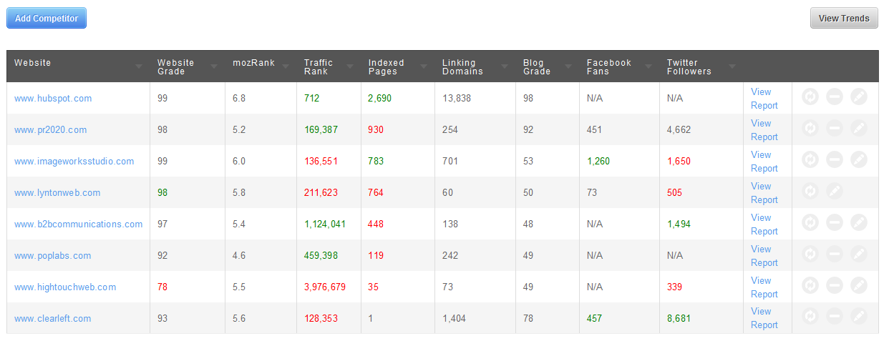
The Competitors Report – Top of the Funnel and conversation starter
Enter their Competitors’ info…
Free Trial → Analyze → Competitor Grader → Enter Competitor
1.
2.
3.
4.
Notes:
David:
If you haven’t already started a trial for your prospect now is the time to do that. Trial portals collect info over time. So, the earlier you create it, the better.
You should enter their competitors in to the competitors tool. There are 3 columns that are most critical to identifying how they’re competitors are doing what they’re doing. They are google indexed pages, inbound links and the overall website grade. Indexed pages tells your prospect how many keywords they can ultimately optimze their site around. If their competitor has 1,000 pages and they have 1,000, their competitor can target 1,000 keyword phrases and they can only target 100 or so. That’s potentially 10x more search traffic they can get compared to your prospect. Inbound links, as I’m sure you know, are the really critical part of SEO. Inbound links helps google determine which site should get ranked higher. A competitor with 10x more links is going to be much more likely to get more search traffic too.

Slide 37
The Competitors Report Guidelines and Storyboard
Have at least 5-7 competitors setup in the tool
Control the data with a story:
They are behind their competitors and need to catch up
They are ahead of their competitors and need to find a way to stay ahead
It’s a dead heat; everyone’s close numerically so the first person to adapt and leverage inbound marketing services will be the clear winner
Notes:
Corey:
If this stuff is newer to you, here’s a quick explanation of what lessons to teach your prospect from the data in the competitors report.

Slide 38
Middle of the Funnel – Get The Details – See Your CAM For More Questions
Once you get more visitors to your site, what do you want them to do?
Doing SEO, social media, blogging is great, but why would you put all of that time into it?
What goal would you want to achieve in order to justify that time investment?
Notes:
David:
Now that you understand what they are and aren’t doing to help their website get found by more visitors, now it’s time to talk about how they can start turning those visitors into leads and customers.
Here’s some questions you should ask to make the transition?
One that I love to ask is, “At this point, usually people are overwhelmed by the amount of effort required to leverage SEO, blogging and social media to attract more traffic to their site. Since you’ll need to invest time and money in this, what goal would you want to achieve in order to justify that investment?”

Slide 39
“Inoffensive Close”
Do you believe I’m starting to understand some of your goals and challenges?
Did the information and concepts that we reviewed today, give you a better picture of how we can help you?
Would you like to continue discussing how we might help you?
Notes:
David:
Once you’ve had deep discussions about traffic acquisition and lead generation, it’s time to talk to them about whether they’d like to move to the next step.
We recommend that you check in with your prospect at this time and ask them what they think so far.
This is a series of 3 questions that are an adaption of the “Inoffensive Close” technique. You’re, of course, not closing the deal, but you’re asking for their commitment to invest more time with you.
Many prospects will say they are ready to get started. I highly recommend you do some goal setting with them first. You’re going to ideally work with this company for years to come providing them services. No company pays for services for years unless the services are helping them achieve their business goals.
So, take your time and figure that out.

Slide 40
Closing the IMA – Booking a Diagnostic Call
Based on what I’ve learned today, there seems to be a lot of opportunity for you to leverage inbound marketing to achieve your goals. Assuming you agree, our next step is to setup another call where we do a deeper diagnostic and set goals together. Would you like to set that up?
During this call, we’ll also need to talk about your budget, timing for investment, who will do what work, and your decision making process. If we come up with a solid plan that includes all of these details and you’re confident in our abilities, do you see any reason why you wouldn’t hire us to help you achieve your goals?
Notes:
Corey:
Once you’ve had deep discussions about traffic acquisition and lead generation, it’s time to talk to them about whether they’d like to move to the next step.
We recommend that you check in with your prospect at this time and ask them what they think so far.
This is a series of 3 questions that are an adaption of the “Inoffensive Close” technique. You’re, of course, not closing the deal, but you’re asking for their commitment to invest more time with you.
Many prospects will say they are ready to get started. I highly recommend you do some goal setting with them first. You’re going to ideally work with this company for years to come providing them services. No company pays for services for years unless the services are helping them achieve their business goals.
So, take your time and figure that out.

Slide 41
Additional Tools
FOR ADVANCED VARs ONLY CONSULT YOUR CAM FIRST
Notes:
Corey:
Tons of great homework this week. Since everyone has been doing such a great job generating and researching leads let’s get on the phones and book some qualification calls!

Slide 42
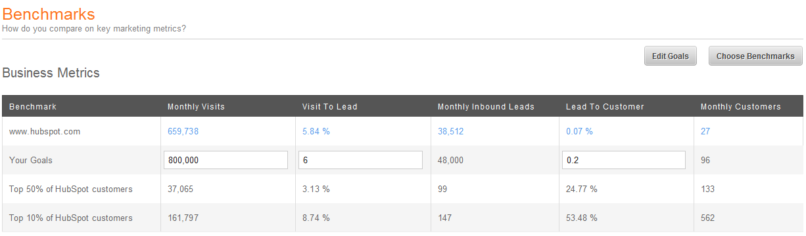
Benchmarks App
Enter their Goals… Traffic, Leads, Sales
Free Trial → Analyze → App → Install Benchmarks App
Notes:
SEE VAR IMA PLAYBOOK FOR SETUP DETAILS AND YOUR CAM

