Slide 1
Diagnostic and Goal
Setting
Notes:
Jeetu:
Welcome to Session 5 of the Partner Program training webinar series for marketing agencies and independent marketing professionals.
My name is Jeetu Mahtani and I am joined by Corey Beale. We are both Partner Channel Managers at HubSpot.
Corey:
We partner with marketing agencies of all kinds to help agencies more cost-effectively and more efficiently provide a broader set of inbound marketing and demand generation services to our mutual customers.
Working with our partners, one of the biggest challenges that they have is adapting to a world where clients are asking for one agency that can do everything. The worlds of PR, advertising, marketing, seo, ppc, social media and web design and development are merging. And the feedback I’m getting from many types of agencies is that it’s really hard to do everything, deliver an ROI to clients and grow their agency at the same time.
That’s what HubSpot is helping partners with in many ways. Today, though, we’re going to talk about a framework for diagnosing the complete inbound marketing needs of a prospect or client. We’re going to provide you with a script and a playbook with how we’ve done this for about 10,000 companies.

Slide 2



Nice to Meet You
Jeetu Mahtani
HubSpot Sales Manager
http://www.linkedin.com/in/jeetumahtani
jmahtani@hubspot.com
Corey Beale
Hubspot Sales Manager
www.linkedin.com/in/coreybeale
cbeale@hubspot.com
Hash Tag: #AgencyTransform
Notes:
Corey:
We want to keep these sessions interactive both during and after the webinar. Feel free to reach out to either of us via email or LinkedIn and let’s get Twitter rocking today by using the hash tag #AgencyTransform

Slide 3

Notes:
Corey:
Ok ok this is the last time I promise. Before we dive right in to the agenda there are a few quick house keeping notes we should make about today’s session.

Slide 4
Bookmark this Page!!
http://www.hubspot.com/advanced-sales-training-home
Notes:
Corey:
Make sure to keep this handy, each week we’ll be uploading the recording and slides to this URL

Slide 5
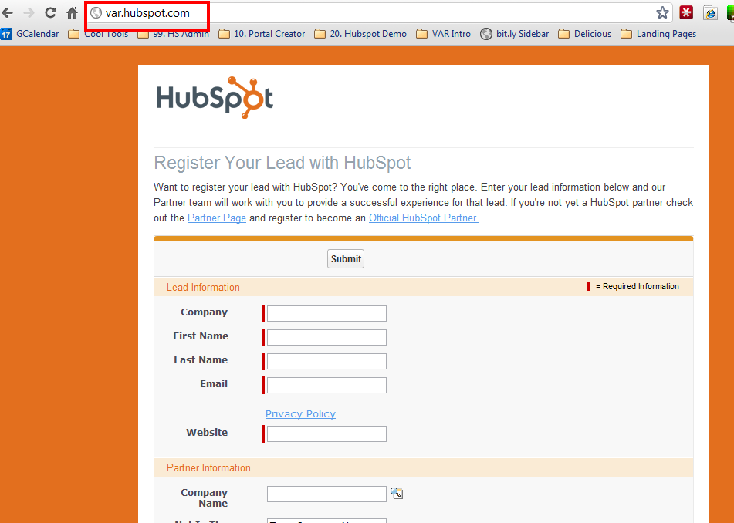
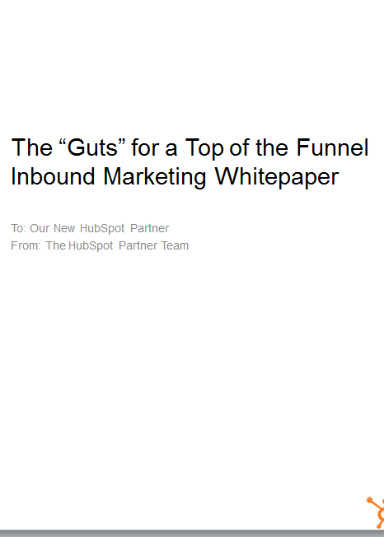


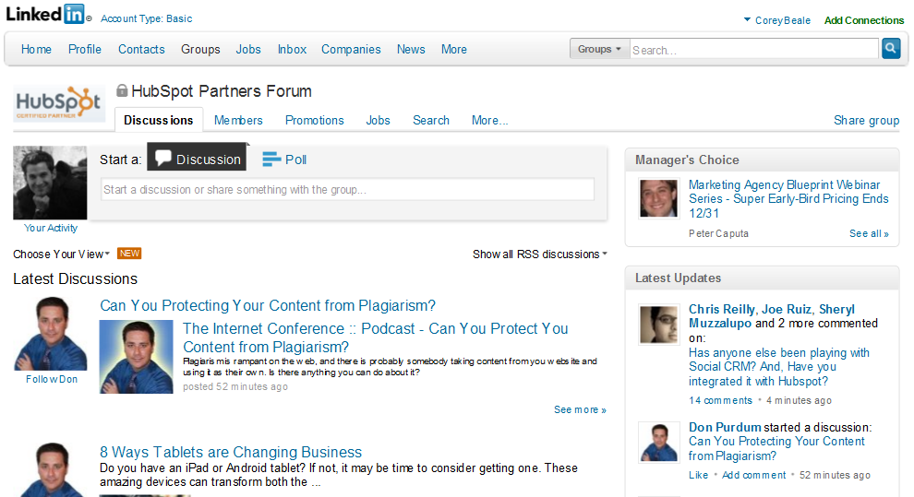
Notes:
Corey:
We’re recording
Register your leads, as often as possible and as many as possible.
Get your ebooks
Hang out with your CAM and discuss opportunities
Join the LinkedIn group!

Slide 6
AGENDA
1
Recap: The recommended sales process
2
Purpose of the Diagnostic & Goal Setting Call
3
The typical flow and “how to” of a call
4
Inbound Marketing Calculator
5
Potholes
6
Key-Takeaways and homework
Notes:
Jeetu:
Here’s an overview of what we’re going to talk about today. The topic is around the diagnostic and goal setting call. We are going to do a quick recap of the sales process and where we last left off, begin to touch on the purpose and background of the goal setting and diagnostic, move in to the actual flow of the call, quickly hit potholes that people typically hit then move right in to talking about the key take-aways homework for this wee.
We’ll share with you a how-to process to execute a Connect call successfully. As part of any Connect, there will be objections, pushbacks, and possibly the big No. We’ll talk about strategies to deal with these scenarios. We’ve also included a bonus section on dealing with influencers and gateways. Finally takeaways so you can get started with connecting with your prospects.

Slide 7
The Recommended Sales Process & Methodology
1
Notes:
Jeetu:
So let’s get down to it and start talking about the HubSpot sales process and methodology.

Slide 8
Generating Leads
Researching Leads and Prospecting
Connecting and Qualifying
Inbound Marketing Assessment (IMA)
Diagnostic and Goal Setting
Present Solution
Contract and Close
Notes:
Jeetu:
We focused on executing an Inbound Marketing Assessment in the last session. Todays session is focused on Connecting on the phone and initiating your qualification process.
Lets do a quick recap of the sales process. Once you have leads, you will research them, pick up the phone and make that call. If you don’t reach and connect with them, you are going to leave a voicemail and send an email immediately. We talked about the Basho sequence of voicemail and email in our last session. When you do connect with them, you are going to engage them with a positioning statement and start your initial qualification. Following the connect, you are going to have a scheduled call during which you are going to continue your qualification by executing on an Inbound Marketing Assessment also known as an IMA. At the end of the IMA, you should have “trusted advisor” status and do an inoffensive close during which your prospect agrees they need your help and would like to define their marketing goals with you. Following the diagnostic and goal setting call, you are going to share the solution to hit their goals. Wrap that meeting up with an inoffensive close again, they agree they want your help and want to see a contract. You finally present a contract which includes their goals they shared with you and close out the deal.

Slide 9



Inbound Marketing Sales Methodology
1. Generate Leads
Find Prospects to Call On
2. Research and Prospect
Get to a Connect
Lead
3. Connect
Schedule the Assessment
4. Qualify
Determine worthiness for next step
OPPORTUNITY
5. Diagnostic & Goal Setting
Align business goals with activities
6. Presentation & Experimentation
Present Solution and/or Trial
7. Contract & Close
Agree to Proceed
Notes:
Corey:
We’re moving nicely down the funnel and beginning to get in to the meat of the sales process. Again my friendly weekly reminder is to print this out and hang it in your office to you don’t start skipping steps.

Slide 10
The Purpose of a Diagnostic & Goal Setting Call
2
Notes:
Corey:
So let’s begin to breakdown what exactly is the purpose behind a diagnostic and goal setting call and how you can begin to execute it properly.

Slide 11

What is it…
Notes:
Corey:
The diagnostic and goal setting is a call in which you are attempting to gain an in-depth understanding of a their current inbound marketing activities against best practices, identify their historical sales and revenue numbers vs. their goals and share your methodology to help them hit their goals.

Slide 12

Write the Script
Notes:
Corey:
Remember, you’ve already asked all the pain questions in the exploratory call and you know everything about them, now is the time to see if they are willing to change and can actually make that change by moving forward with your services and you. The example to think of is that you are a doctor and already know what’s wrong with the patient, so you use this to clarify and confirm so you write the proper prescription and simultaneously check that they are willing and open to take part in your prescription.

Slide 13
The Typical Flow and “How To” of the Diagnostic & Goal Setting Call
3
Notes:
Jeetu:
So lets look at the typical flow of a goal setting and diagnostic call.

Slide 14
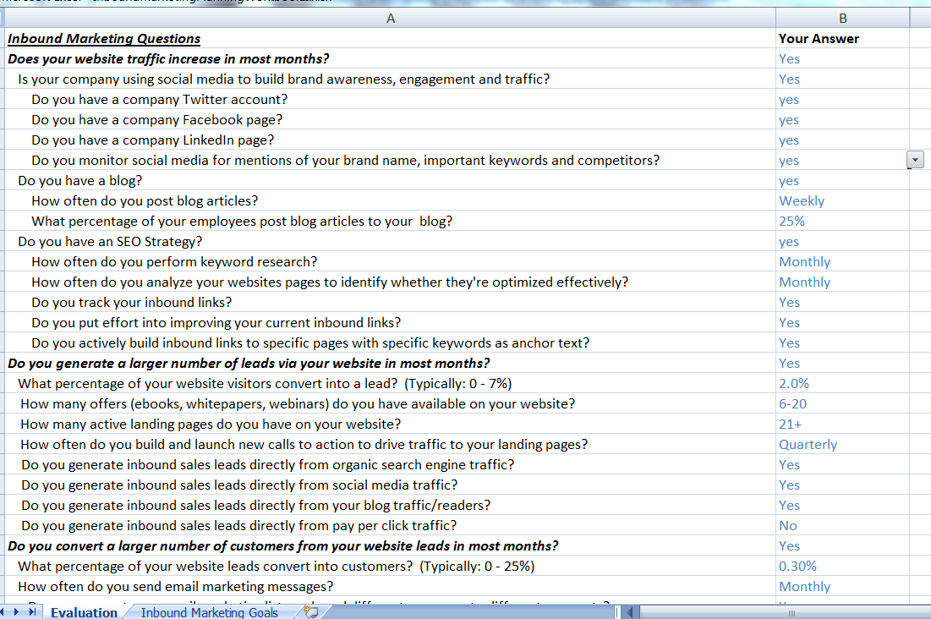
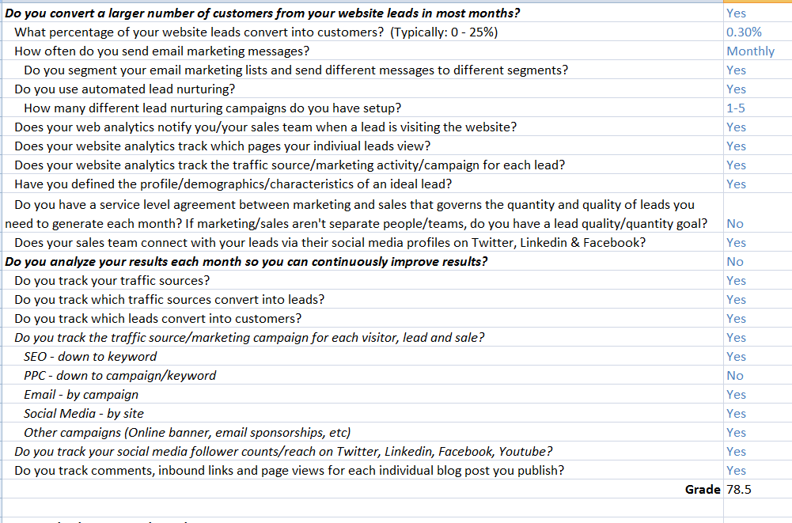
Inbound Marketing Prospect Assessment Tool
Notes:
Jeetu:
The core of a Diagnostic and Goal setting call is a tool or spreadsheet that is also known as a Prospect Assessment tool. It basically is an Excel spreadsheet with two worksheets – an evaluation worksheet and a goal setting worksheet.
Your first step is to use the Evaluation worksheet. The evaluation worksheet comprises of 48 questions. The questions follow the Inbound Marketing methodology framework with sections/questions around driving traffic, converting traffic into leads, nurturing leads into customers, and finally analytics. You probably have answers to several questions based on the IMA call so we recommend you pre-populate the spreadsheet prior to the call and validate any pre-populated answers during the Diagnostic and Goal Setting Call.
The second step is to use the Goal Setting worksheet. This worksheet basically does a reverse funnel so based on their goals in terms of targeted revenue in 12 months, the workseet calculates number of customers, leads, and visitors they would need to generate to hit those goals. It takes into account their current marketing efforts and typically their current marketing efforts will be unrealistic to get them to hit their goals. You will then share with them on how your services with the inbound marketing methodology will help them hit their goals.

Slide 15
Succeeding with the Prospect Assessment Tool
Pre-populate questions based on answers and feedback in the IMA call
  Validate answers while reviewing through diagnostic and goal setting call
Fill out any blanks with the prospect during the call
  Use the “Give and Get” framework while completing blank
Share Inbound Marketing best practices as you step through each of the sections
Notes:
Jeetu:
A couple of points to keep in mind in order to succeed when executing a prospect assessment tool. Many of the questions are based on the Inbound Marketing Assessment. Definitely complete questions to which you have answers prior to this call and use this call to validate their original feedback. When going through questions for the first time, basically the ones that are blank, use the give and get approach that you used in the IMA too. As you go through the questions, give them feedback on how that specific questions impacts the website from a top of the funnel, middle of the funnel, and analytics standpoint.

Slide 16
Start with Evaluation Worksheet
Typical Flow
  Does your website traffic increase in most months? [GET FOUND -> TRAFFIC]
  Do you generate a larger number of leads via your website in most months? [CONVERT -> LEADS]
  Do you convert a larger number of customers from your website leads in most months? [CONVERT -> LEADS -> CUSTOMERS]
  Do you analyze your results each month so you can continuously improve results? [ANALYTICS]
  Historical Sales vs Growth Goals
Notes:
Jeetu:
So lets dig into the typical flow of the first worksheet which is the evaluation worksheet. The worksheet is broken up into sections that follow the inbound marketing methodology. There is a section with questions around getting found, basically the top of the sales funnel. It then digs into questions that cover conversion tactics or middle of the funnel activities. Following getting found and conversion tactics, it digs deeper into questions around lead to customer conversion which in our world includes lead nurturing. Finally, it digs into analytics or closed-loop marketing. As you complete these four sections, it ends up giving you prospect grade from 1 – 100, 100 being the best. Now you are at a point where you understand what they are doing today from a marketing standpoint but you also need to understand the impact they would like to have to their business from a revenue standpoint. The final section digs into their current revenue across recurring revenue clients and project based clients. It compares this against their 12 month target and indicates whether they are going to pass or fail towards hitting their goals if they kept doing what they are doing today. I am sure some of you are smirking but it does really give them a Pass or Fail score. Most business owners will not want to see a shortfall on a spreadsheet and a Fail being assigned to them.

Slide 17
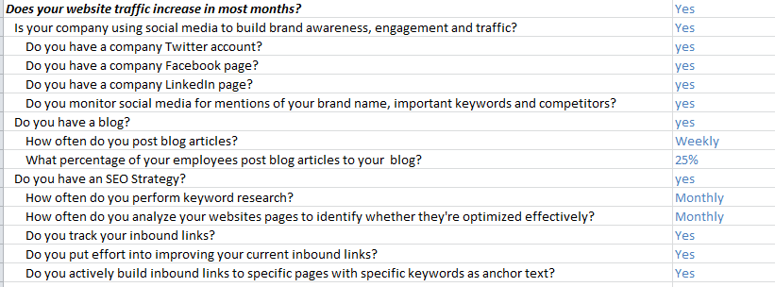
1: Does your website traffic increase in most months?
Notes:
Jeetu:
So the first set of questions is around whether their website traffic increases in most months. There are questions around social media and are they using it to build brand awareness, engagement and traffic. It digs into their blogging and SEO strategy. Now do remember that several of these questions would have come up in your Connect call and your IMA so prepopulate these questions with answers from previous calls. It is another reason why you want to take great notes in your Connect and your IMA.

Slide 18
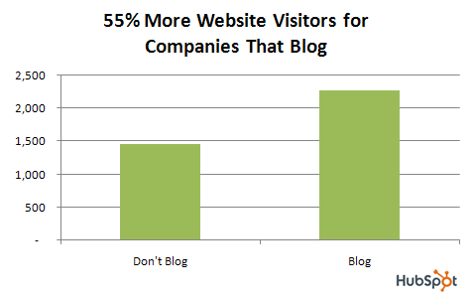
1. Blogging + SEO + Social Media = Traffic
http://blog.hubspot.com/blog/tabid/6307/bid/5014/Study-Shows-Small-Businesses-That-Blog-Get-55-More-Website-Visitors.aspx
Notes:
Jeetu:
Now as you go through these questions, always be in a give and get mode. In the case of generating traffic that increases in most months, you could share how content that is optimized and shared on social media generates increasing amounts of traffic. HubSpot has a ton of great metrics one of which is that companies who blog get 55% more visitors vs. companies that don’t.

Slide 19
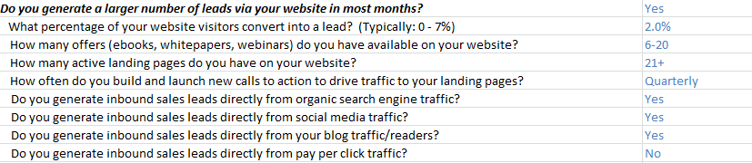
2. Do you generate a larger number of leads via your website in most months?
Notes:
Jeetu:
The next set is around generating a larger number of leads through their website in most months during the year. It digs into conversion tactics using landing pages and offers. It also sees is generating and able to track leads from organic traffic, blogging, social media and PPC.

Slide 20
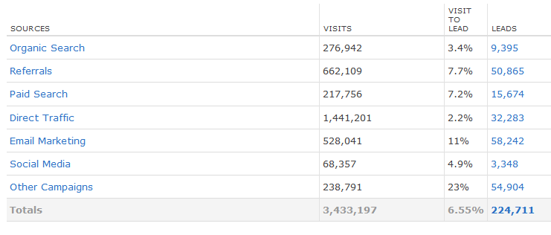
2. Quickest Path to ROI: Improving Visit → Lead Ratio
http://www.hubspot.com/lead-generation-marketing-hub/
Notes:
Jeetu:
With visit to lead and improving your conversion rates, you can share how you track different traffic sources for each of your clients

Slide 21
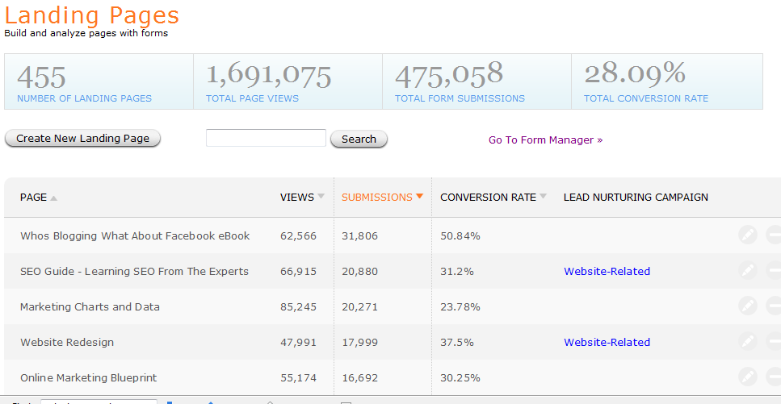
2. So… More Compelling Offers & Landing Pages
http://blog.hubspot.com/blog/tabid/6307/bid/4793/Are-Your-Compelling-Offers-Actually-Compelling.aspx
Notes:
Jeetu:
And then share metrics around how you track which landing pages are generating most of your leads. You can share the concept of landing pages and how compelling content as offers behind landing pages will help them convert a higher percentage of their traffic into leads.

Slide 22
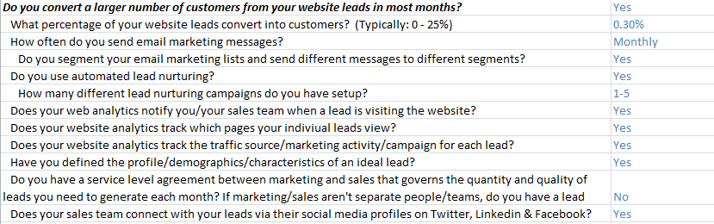
3. Do you convert a larger number of customers from your website leads in most months?
Notes:
Jeetu:
The next set is around converting a larger number of generated leads into paying customers. It digs into tactics around lead nurturing.

Slide 23
3. Improve Lead to Customer Conversion Rates
According to an MIT Study with InsideSales.com, 78% of sales that start with a web inquiry go to the company that responds FIRST!
According to Focus, it is only in the last third of the buying process that prospects actually want to engage with a sales representative.
Of those surveyed by sales lead expert Mac Macintosh, 23% had bought the product or service they were inquiring about within 6 months. The other 67% still intended to purchase, but were not yet ready.
According to DemandGen Report, nurtured leads produce – on average – a 20% increase in Sales Opportunities versus non-nurtured leads.
Notes:
Jeetu:
Here are some great data points around lead nurturing.
Source data: MIT Study with InsideSales.com

Slide 24
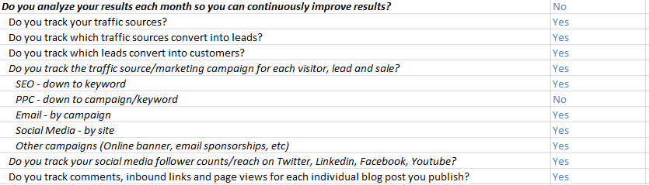
4. Do you analyze your results each month so you can continuously improve results?
Notes:
Jeetu:
The final section before giving them a grade from 1 – 100 is around Analytics and whether they analyze their results each month to continuously improve their marketing activities and which impact their results.

Slide 25
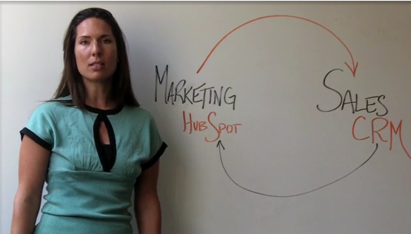
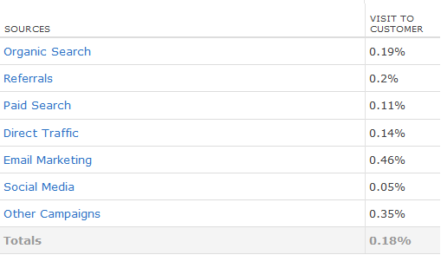
4. What Can Be Measured, Can Be Improved
http://www.hubspot.com/products/closed-loop-marketing/
Notes:
Jeetu:
You can share

Slide 26
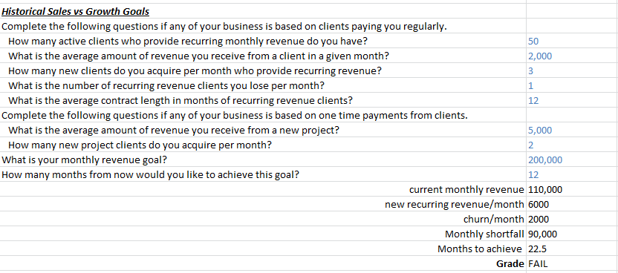
Historical Sales vs. Revenue Goals
If FAIL: If you keep acquiring the same number and mix of clients, you won’t achieve your revenue goal. Do you want to figure out how to close the gap via inbound marketing?
Notes:
Jeetu:
So you have given them a grade and in most cases the grade is going to like low but again it just a grade and what they really care about is hitting their revenue goals and whether your marketing services can help them hit their goals. In this section, you ask them questions around their revenue across retainer clients and project based clients. The questions are around # of clients, average retainer or project size, contract lengths. It then asks them their monthly revenue goal and by when they would like to hit it. It then calculates the shortfall and indicates whether they are going to hit that goal (pass) or fail because there is a gap or shortfall. You can use a statement like “if you keep acquiring the same number and mix of clients…”. In a few cases, they may actually pass and you could use a statement like “Why are we talking about inbound marketing…”

Slide 27
Historical Sales vs Revenue Goals
If PASS: Why are we talking about inbound marketing? If you just keep doing what you’re doing, you’ll achieve your revenue targets.

Slide 28
The Inbound Marketing Calculator
4
Notes:
Jeetu:

Slide 29
Typical Flow
Set Numeric Inbound Marketing Goals
Qualifying Budget, Authority, Timing
Getting Commitment & Booking Next Steps
Asking for More Help…
Notes:
Jeetu:
So you’ve completed the evaluation, it is very possible they’ve failed…they do in most cases. You have continued to establish yourself as a trusted advisor by being in a give and get relationship. And have concluded the evaluation by showing them through the data that if they continue doing what they are doing today in terms of marketing activities, they will not hit their goals. This is tough message for most business owners and decision makers to swallow. They are probably eager to see how you can help them cover that gap and get them to hit their goals.

Slide 30
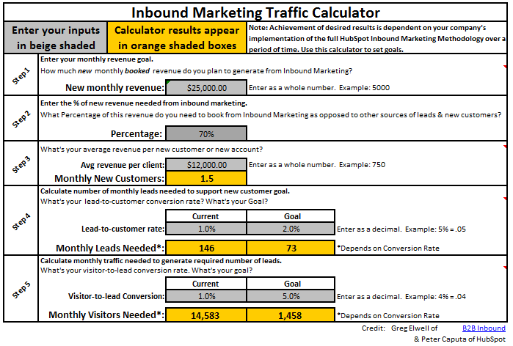
Inbound Marketing Calculator V 5.0
Download: http://www.hubspot.com/partner-program--inbound-marketing-calculator
Notes:
Jeetu:
So the calculator is in the second worksheet titled “Inbound Marketing Goals”

Slide 31
What the Calculator Helps You Do
Ask Why, When, How, What Else, What if?
Help your prospect set traffic/lead generation goals based on their sales and revenue targets
Help them understand the effort and expense required to achieve their goals via inbound marketing.
Notes:
Jeetu:
Now the overall goal of the calculator is to help the prospect clearly see what they would need to generate in terms of customers, leads, and visitors to hit their 12 month revenue target. As you help them define this better, it also enables you to continue qualifying and continue asking questions around their goals, what happens if they hit their, what happens if they don’t…

Slide 32
Getting Agreement to Complete the Calculator
“Based on our conversations so far, it sounds like you’re serious about growing your business. Our next step is to help you set your online marketing goals based on your sales and revenue targets. Would you like to run through these numbers with me now?”
Notes:
Jeetu:
Now before completing the calculator, you do want to get agreement to complete it. It is similar to an inoffensive close since it gets the prospect to share whether they are ready to fix their problems and the first step is to set their marketing goals based on sales and revenue targets.

Slide 33
Input: Monthly Booked Revenue Goal
Based on the difference between your current revenue and your goal, this calculates the amount of new revenue you need to book in order to make up for the shortfall. Does this number look about right?
If it’s not right, what is the total amount of monthly booked revenue you need to generate?
Notes:
Jeetu:
Now there are sections that are automatically calculated based on the evaluation worksheet. Step 1 is to identify their monthly revenue goal.

Slide 34
Input: What % of Revenue Is Coming From IM?
What other methods will you be using to generate leads and new customers?
Are you confident that these other methods will help you hit your goal?
How far off do you think you’ll be if you don’t figure out how to leverage the web to generate more leads?
Notes:
Jeetu:
In Step 2, the prospects shares what % of their monthly revenue target would they like to come from inbound and online marketing. You can continue asking questions.

Slide 35
Input: What’s Your Average Revenue Per Client?
Based on the evaluation, we see that your average revenue per client is about _________.
Is this the right number? Should it be higher or lower?
Other question: Are you reaching the right clients with your sales and marketing efforts? Do you think you could charge more for a specific type of customer? Do you think we can attract that type of customer via IM?
Notes:
Jeetu:
In Step 3, the average revenue per client is determined from data in the evaluation worksheet. It then calculates monthly new customers that are needed. Continue asking questions…

Slide 36
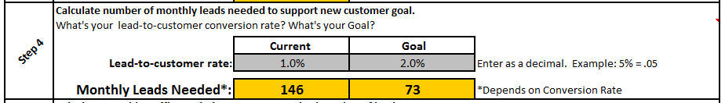
Input: Lead → Customer Conversion Rate
Based on the evaluation, this is your lead to customer conversion rate. Does it look right?
Is it different depending on the source of the lead?
Other questions:
  What methods are you using to generate leads now? (Referrals, Cold calls, Networking)
  Are you using lead nurturing, closed loop marketing analytics or lead intelligence? (Educate)
Notes:
Jeetu:
Their current lead to customer conversion rate is retrieved and this calculates the number of monthly leads that are needed.

Slide 37
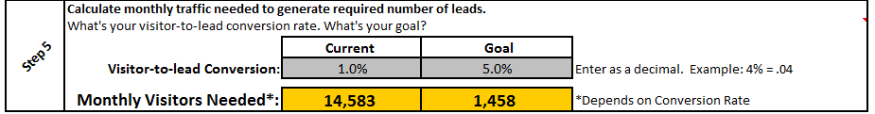
Input: Visit → Lead Conversion Rate
Based on your evaluation, this is your visit to lead conversion rate. Does this look right?
Other questions:
  What kind of compelling offers do you have on your site that prompt visitors to share their information?
  Do you know how your leads are finding your site? Is your visit to lead conversion rate different for different sources of traffic?
Notes:
Jeetu:
We continue down a reverse funnel by digging into visit to lead conversion rate.

Slide 38
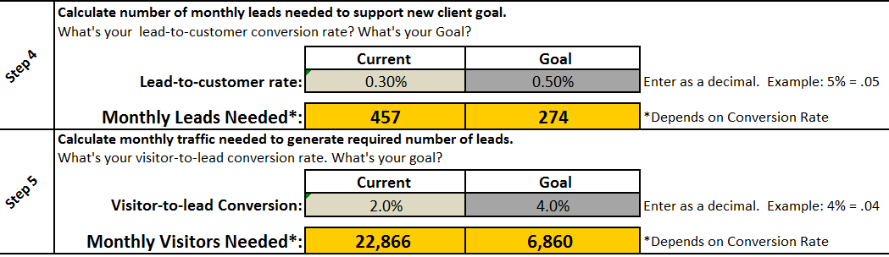
Help them Understand What Variables Impact Results
Notes:
Jeetu:
As you’ve completed Step 5, you have really broken up their funnel in a reverse fashion since based on their revenue targets and % that will come from inbound marketing, they have an understanding of the number of customers, leads, and visitors needed in order to hit their goal. Based on their current conversions, it will share number of leads and visitors needed in order to hit their goal. In most cases, the number of visitors needed in comparison to what they are really generating today is going to be a huge difference.

Slide 39
Reiterate What Activities Impact Results
Improving visit → lead conversion rate
  Creating lots of compelling offers and landing pages, calls to action
Increasing traffic
  Blogging! blogging! blogging Smart so it helps w/ SEO and Social Media
Increasing lead → customer conversion rate. boost sales productivity:
  Lead nurturing & lead Intelligence, crm integration
Improvement over time:
  Sources, closed loop marketing analytics
Notes:
Jeetu:

Slide 40
Next Step
Set Numeric Inbound Marketing Goals
Qualifying Budget, Authority, Timing
Getting Commitment & Booking Next Steps
Asking for More Help…

Slide 41
In order to hit your goals, you’ll probably need to dedicate at least 10-20 hours/month to inbound marketing. Who will do that? Internal resource or outsourced?
More hours = more success, of course.
How much content needs to be created? Who will do it?
What can you afford to invest now in order to hit these goals?
Are you planning to reallocate funds from something else?
Notes:
Corey:
Once you’ve established their goals, now it’s time to uncover their budget.
Every company wants to generate more and better leads starting yesterday. But, not every company will be able to invest the resources needed to achieve it. Most companies will need to steal dollars from another budget in order to achieve these goals.
So, start by asking them who will do the work and what internal resources they can bring to the table. Very few companies will have all of the right resources internally. That’s where you come in. You will need a certain amoutn of time involvement from them or their team to successful build compelling offers for lead generation, create blog content and interact via social media sites.
They should understand that the more hours they commit, the more success they will achieve.
From your analysis before, you should be able to guesstimate how much time needs to be invested in order to achieve their goals.
Then, you should ask them what they can afford to invest (time and money) to hit their goals.
After you get a feel for that, now would be the time to talk to them about the question that they want answered, “How much is this going to cost me?”

Slide 42
Determine Authority and Influence
Who are all of the stakeholders involved in a buying decision?
Who will be involved in implementing the inbound marketing plan?
What objections/issues will come up when other stakeholders get involved?
What will other decision makers want to know before making a decision?
Notes:
Corey:
Often times, you will not be dealing with the person that writes the checks. The marketing manager might need budget approval from the CEO. Or a business owner might need to talk to their partner. That might be a financial backer or it could be their life partner. As i’m sure many of you know, personal relationships make money discussions with buyers all the more interesting. But, it’s important to discuss how this impacts their buying decisions. There is no sense in either one of you investing 1-4 more hours figuring out how you can best help them if there are other people who might say “no” because they want to invest the money in a family vacation or a trade show instead.

Slide 43
Determine Time Available & Timeline for Success
Who will be involved internally to your company to ensure this plans success?
How much time will they be able to dedicate to IM?
How can we get more of your organization involved in creating content? Social media?
How long do we have before we need to start hitting the monthly goals we discussed earlier? What happens if…
Notes:
Corey:
It’s really important to identify who is going to do the work required to be successful with inbound marketing. This is probably the most important conversation for ourpartners to have as it determines how many hours you need to charge for per month in order to help your client be successful.
Do this thoroughly.
You should also talk about the time between getting started and seeing results. A good sales person can sit down and make progress with cold calling in week one (maybe). But, inbound marketing usually takes an investment of a few months before the fruit gets ripe.

Slide 44
Determine Competitive Situation
What other avenues are you exploring to help solve your marketing challenges?
Are you working with other organization now?
Are you interviewing other organizations now?
At this point, have you discovered any reasons, why you would choose to work with someone else, instead of us?
Notes:
Corey:
Too many times, agencies are too afraid to ask about competition too. By following the process we talked about today, you’ll be separating yourself from the pack by leaps and bounds. Very few agencies follow a process that is so well defined to help the prospect figure out their goals and set a solid plan to achieve them. Most agencies are looking to impress them with a portfolio and “convince” people to work with them. Like interruption marketing, prospective buyers are sick and tired of this process.
Also, you should remember that they’re probably talking to a PR firm over here, and an SEO consultant over there, and a web developer over here. By covering all of these areas, you are creating a simpler, more effective solution for them. By asking these questions, you’ll figure out why they should buy from you, instead of other companies.

Slide 45
Next Step
Set Numeric Inbound Marketing Goals
Qualifying Budget, Authority, Timing
Getting Commitment & Booking Next Steps

Slide 46
Get Commitment, Next Step
What are your thoughts at this point?
What other things do we need to discuss before you’d be ready to hire me/my company to help you implement inbound marketing?
Typically, we’ll put together a presentation so you can understand more about how we’ll actually implement much of the things we’ve discussed. After that, we typically we agree on everything and we’ll sign a contract. Do you see any reason why you wouldn’t move forward?
Notes:
Corey:

Slide 47
Potholes
5
Notes:
Corey:
Now any sales process is going to have objections and pushbacks. If sales did not have any objections and pushbacks, then everyone would be in sales and every call would result in a deal.

Slide 48
Potholes
Giving out too much free information
Getting little in return
Not asking questions
Not being conversational
Not rolling with the punches
Notes:
Corey:
Not preparing adequately
Questions to ask
Flagging items that don’t look right
Not asking the right questions
Not being conversational
Not rolling with the punches
Showing products too early
Not showing proper examples of how others are doing it right
Not getting commitment during the process
Valuing the prospects feelings rather than inquiring about the data
Forgetting to use the big 4 methodology statement

Slide 49
Key Take-Aways and Homework
6
Notes:
Corey:
It’s that time again, so let’s talk about this weeks key take-aways and the homework to help you be successful.

Slide 50
Think of the assessment as setting up a 60 minute time slot where you will be able to speak with the prospect to determine whether you can help them.
This process is for their benefit. When this is done well, prospects will thank you.
You should add value by sharing stories and tips that are relevant to the questions you’re asking.
Inbound marketing works VERY well when it’s done right. You are the expert. You should guide the conversation. Don’t let the prospect drag you off course. Your time is valuable.
If you can think you can help them, your objective is to set up the “Presentation and Experimentation” call.
Notes:
Corey:
Lastly, I think it’s important that you’re not afraid to tell people you can’t help them. You are asking all of these questions to see whether you can help them or not. If they aren’t willing to share openly, or invest the right amount of resources, they won’t be successful. They won’t re-hire you if they aren’t successful. You should spend your time serving companies that you can help that will renew with you every year. This is how you will be successful. The more successful your business is, the more people you will be able to help.

Slide 51
Your success in sales is driven by
Activity
Process
Skills
Notes:
Corey:
No changes here this week folks, nothing can replace activity at this stage either. Keep hitting the phones hard, calling your well researched leads and start booking appointments.

Slide 52
Homework
Execute on 3 Diagnostic and Goal Setting Calls
  Schedule 3 next step appointments
Use the numbers!
Notes:
Corey:
Tons of great homework this week. Since everyone has been doing such a great job generating and researching leads let’s get on the phones and run some diagnostic calls!

Slide 53

Tuesday, February 21
11 AM US EST
Next Topic – “Presentation
and Experimentation”
Notes:
Corey:
Talk to slide

Slide 54
Questions?

